Slide 1

(EL)² Poster
Presentation Tips
Adapted from a presentation given by
Prof. Angela Gutchess
Department of Psychology
Created with permission by Jessica Paquin
Academic Internship Administrator
Office of the Dean of Arts & Sciences / Hiatt Career Center

Slide 2
Why present at (EL)²?
(EL)² is a University-wide symposium highlighting the many ways undergraduates connect experience to their Liberal Arts education.
This is a great opportunity for undergraduates to:
Gain experience in presenting your work in a formal setting
Receive feedback from faculty and peers
Share ideas and learn from other students
Enhance your resume

Slide 3
Goals of Experiential Learning
When creating your poster, remember Experiential Learning is:
An Intellectual Challenge
Tackle real-world problems for which there are no answers in the back of the book.
Challenge your powers of observation, analysis and creative thinking.
Test theories against the concrete; experience, create and prove new theories.
A Practical Experience
Explore the world of a professional in the field.
Ask yourself, "Is this field the right fit for me?"
Sharpen applications for graduate school and employment by documenting skills and experience.
Opportunity for Personal Growth
Develop skills to work in groups or independently.
Appreciate differences in learning style, values and world view.
Practice taking informed risks, and learn from mistakes as well as successes.
htwww.brandeis.edu/experientiallearning/for students/index.html

Slide 4
Posters:
Usually 1 foam board
No tri-folds
40” x 30 or 32”
White or black
Project Title
  Name
  Year
  Contact Info
32”
40 ”

Slide 5
Posters: What’s your story?
What did you do?
  Why interesting? Important?
But not ONLY about what you did
  Outcomes? Who was affected?
  Reflection? How were you affected?
  Helpful information/advice to share with others?
  Why would others want to know about this?

Slide 6
Make an Outline:
Begin to make a mental outline
  What journey do you want people to take?
What were the biggest issues?
…Unexpected results?
…Proudest achievements?
…Lessons learned?
What are your next steps?

Slide 7
Effective Posters:
Readable
Legible
Well-Organized
Succinct

Slide 8
Effective Presentations: Readable
Limited time to convey your message to your audience
  May have <3 minutes/person
  What are your most important points?
  Choose one memorable message
  Avoid grammar & punctuation mistakes
  Do the topics resonate with the audience?
    Why should they know this?
    The “grandmother” rule: Would she understand it?

Slide 9
Effective Presentations:
Legible
  Studies show you only have 11 seconds to grab and retain the audience’s attention.
  Aim for “visually clean and pleasing”
  Can they read it from 6-10 feet away?
  A poster is not a cut-up essay
  (Again)What are your most important points?
  Large font!! (30+ point)
  High contrast font colors
  Borders or mounting sections of text help

Slide 10
Effective Presentations:
Well-Organized
  Spatial organization makes the difference between reaching 95% rather than 5% of the audience.
  Audience shouldn’t have to hunt for main idea/ takeaways
  Space in-between sections; Visually neat
A good flow of logic
Impactful, short titles
  Avoid jargon
  Borders or mounting sections of text help

Slide 11
Effective Presentations:
Succinct
Don’t overwhelm them, entice them!
  Think of 1-2 sentences to say to everyone
  What are your most important points? Your one memorable message?
Keywords and Section headings that make an impact
Pictures and graphs instead of paragraphs

Slide 12
Keep in Mind…
Show, don’t tell
  Less (text) is more
  Bullet points
Can you use organization’s handouts?
Photos & figures speak volumes and break up sections
Use of color (if you can)
  Printing
  Borders/mounting

Slide 13
Suggested Headings / Sections :
May differ depending on the type of poster (Science Research vs. others)
Personalized Titles
Methods
Outcomes
Research Topic/ Problem
Organization/Lab
Challenges
Successes
Lessons Learned
Highlights of the Experience
Next Steps… where is this taking you?

Slide 14
See For Yourself
Note the next slide…
Too much information
Too many details
Too little space between sections
Results aren’t obvious

Slide 15





Contextual False Memories and Aging
Angela Gutchess^{1, 2}, Elissa Aminoff ^{2, 3}, Moshe Bar², & Daniel L. Schacter^{2, 3}
¹Brandeis University, ²Massachusetts General Hospital, ³Harvard University
INTRODUCTION
False recognition of related information occurs more frequently with age. For example, older adults are more likely to false alarm to new exemplars drawn from categories of previously studied pictures, such as a new picture of a cat after encoding pictures of other cats (Koutstaal & Schacter, 1997; Koutstaal, 2003).
Recent data (Aminoff, Schacter, & Bar, in press) illustrate that related contextual information can lead to false recognition in young adults. Items that occur in the same spatial contexts (e.g., stove and a dishwasher from a kitchen context) are prone to false recognition. Because contextual false memories rely on related information, older adults may be expected to exhibit elevated rates of false recognition. However, contextual information can support accurate memory and the benefits from it may be relatively intact with age (e.g., Chee et al., 2006; Gutchess et al., 2007). This study investigated the influence of age on false memories for contextual information.
Experiment 1
METHODS
28 young (M age = 23.7) and 28 older (M age = 71.4) adults viewed photos of individual objects on light gray backgrounds. Participants incidentally encoded 84 strong context picture pairs (see below) and 39 weak context picture pairs (e.g., camera & scissors) by rating the extent to which the picture pairs constituted a context (1=‘objects don’t fit a context’, 2=‘only the depicted objects fit a context’, 3=‘only a few more objects fit a context’, 4=‘many more objects fit a context’). Pictures were presented for 2000 msec, followed by a ratings scale for 2000 msec, and trials were interspersed with fixation trials.
After a 24-hour retention interval, participants judged whether words corresponded to pictures they had studied on the previous day. In a self-paced design, participants decided whether or not they saw a corresponding picture in the first part of the study for 162 words, and made a “Remember”, “Know”, or “New” judgment. 84 of the words corresponded to studied strong contexts, with 42 targets and 42 lures. 78 words were weak context items, with 39 target and 39 lures.
RESULTS
We replicated previous findings for young adults that strong contexts enhanced both hit and false alarm rates. While older adults showed a similar increase in hit rates for strong contexts, their false alarm rate was no higher for strong than weak contexts. This finding contrasts previous research showing an increase in false alarms with age to related information.
Hits False Alarms
Main effect of context, F(1, 54) = 74.45, p<.001 Main effect of context, F(1, 54) = 20.56, p<.001
No effect of age, F(1, 54) = .00, p>.95 No effect of age, F(1, 54) = 1.08, p>.30
No interaction, F(1, 54) = .51, p>.45 Age x ctx interaction, F(1, 54) = 3.93, p=.05
Experiment 2
The results of Experiment 1 suggest that young, but not older, adults are more prone to commit false alarms to strong contexts than weak contexts. Although this finding represents a potential exception to the tendency for older adults to have higher rates of false memories for related information, it is possible that older adults found the contexts less rich than younger adults, or did not generate contextually-related items during encoding to the same extent as young. Experiment 2 explored these possibilities.
METHODS
17 young (M age = 23.2) and 17 older (M age = 74.6) adults participated in this experiment. With the exception of the nature of the memory test, the methods were identical to Experiment 1. Participants completed an inclusion test (adapted from Brainerd & Reyna, 1998; Schacter, Cendan, Dodson, & Clifford, 2001), making judgments of whether the words presented at recognition corresponded to, or were related to, a previously studied context. This modified recognition test allowed us to assess the extent to which young and older adults encoded the contexts and assessed the recognition items as related to them.
RESULTS
Results indicate that young and elderly do not differ in the extent to which they consider items to be related to previously studied contexts. This suggests that the results of Experiment 1 do not reflect age differences in ideas about what consistutes a context, or the ability to generate items related to a context.
Main effect of context, F(1, 32) = 13.41, p<.002
Main effect of veridical studied item vs. related, F(1, 32) = 59.35, p<.001
Trend for an interaction of context x related/old, F(1, 32) = 2.88, p=.10
No trends for main effects of interactions involving age, Fs<1.5
Participants rated the relatedness of the critical target or lure item to the original context pair (e.g., stroller-bottle, crib) as an additional measure of the extent to which items were perceived as contextually-related. All three items were presented to participants so that this task made no memory demands. A rating of ‘1’ indicated “definitely yes (the item fits the same context as the pair)” and a rating of ‘4’ indicated “definitely no”. The average ratings for the triplets were: Young = 1.51 Elderly = 1.37
Across all items, elderly rated the items as significantly more related to the contexts than the young adults, t (334) = 3.29, p<.001.
DISCUSSION
In Experiment 1, we present evidence that strong related contextual information, compared to weak contextual information, leads young adults to commit memory errors disproportionately more than older adults. This finding contrasts a wealth of literature showing that older adults falsely recognize related information more than young adults (e.g., Koutstaal & Schacter, 1997; Koutstaal, 2003). Although for both young and elderly hit rates are similarly higher for strong contexts than weak, Experiment 2 addresses the extent to which contexts were considered differently across the age groups. On the basis of age-equivalent performance on an inclusive memory test and similar ratings of contextually-related triplets, we rule out the alternative explanation, that contexts were impoverished or less meaningful for older adults than young.
Even under conditions in which young adults are prone to commit memory errors, older adults are no more prone to falsely endorse items strongly related to specific contexts than those weakly related to many contexts. We suggest that the rich, supportive information provided by contexts can facilitate memory with age, supporting accurate recognition without leading older adults to generate false memories.
bottle
crib
ACKNOWLEDGEMENTS: We gratefully acknowledge Kelly Fitzgerald, Sarah Stein, and Allie Indeck for assistance with data collection and analysis.
CONTACT: gutchess@brandeis.edu
REFERENCES
Aminoff, E., Schacter, D. L., & Bar, M. (in press). The cortical underpinnings of context-based memory distortion. Journal of Cognitive Neuroscience.
Brainerd, C. J. & Reyna, V. F. (1998). When things that were never experienced are easier to “remember” than things that were. Psychological
Science, 9, 484-489.
Chee, M. W. L., Goh, J. O. S., Venkatraman, V., Tan , J. C., Gutchess, A., Sutton, B., Hebrank, A., Leshikar, E., & Park, D. (2006). Age-related
changes in object processing and contextual binding revealed using fMR-Adaptation. Journal of Cognitive Neuroscience, 18, 495-507.
Gutchess, A.H., Hebrank, A., Sutton, B., Leshikar, E., Chee, M.W.L., Tan, J.C., Goh, J.O.S., & Park, D.C. (2007). Contextual interference in
recognition memory with age. Neuroimage, 35, 1338-1347.
Koutstaal, W. (2003). Older adults encode--but do not always use--perceptual details: intentional versus unintentional effects of detail on memory
judgments. Psychological Science, 14, 189-193.
Koutstaal, W., & Schacter, D. L. (1997). Gist-based false recognition of pictures in older and younger adults. Journal of Memory and Language, 37,
555-583.
Schacter, D. L., Cendan, D. L., Dodson, C. S., & Clifford, E. R. (2001). Retrieval conditions and false recognition: Testing the distinctiveness
heuristic. Psychonomic Bulletin & Review, 8, 827-833.

Slide 16
See For Yourself
Better...
Much more space between ideas
Sections are clear
Discussion reduced and readable
Graphics steal the show
Want to spend time getting gist
Don’t overwhelm them, entice them!

Slide 17

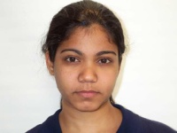
Aging Affects Memory for Valenced Character Information
Megan J. Limbert & Angela H. Gutchess
Brandeis University
INTRODUCTION
-Age differences in memory performance disappear when the content is socioemotional or personally meaningful (Rahhal et al., 2002; May et al., 2005)
- According to Socioemotional Selectivity Theory, emotional, specifically positive, information, is prioritized with age (Carstensen, Isaacowitz, & Charles, 1999), but it may be that the advantage of emotion holds only for remembering general ideas as opposed to specific details
-There is evidence that the way in which older and younger adults differ in memory performance based on the positivity or negativity of images changes as a function of whether that memory is for general or specific information (Kensinger, Garoff-Eaton, & Schacter, 2007)
-We sought to compare how young and older adults remember both general and specific information when that information is socioemotionally relevant or neutral
METHODS
- 20 young (M age = 18.95) and 20 older (M age = 75.15) adult participants
- 48 faces paired pseudo-randomly with 48 names and sentences designed to color the individual in a negative, positive, or neutral light
-Faces rated similarly on memorability, familiarity, & mood (Kennedy, Hope, & Raz, in press)
  -Positive and negative sentences no different on ratings of arousal (t = -1.846, p > .05 [two-tail]) or valence (t = .709, p > .05 [two-tail]) for positive and negative groups.
  METHODS (cont’d.)
-Each pairing presented for 5 sec. during encoding; participants were asked to form an impression of each individual
-During recognition & recall phase, each face & name presented again; participants were asked:
- “What kind of impression did you form of this person?” (forced choice
of good, bad, or neutral, which assessed memory for the character/impression of the individuals - general memory )
  -”What else do you remember about this person?” (assessed memory for the associated behavior/characteristic - specific memory)
  RESULTS
  Response Bias
  -Evidence for systematic bias in the way participants guessed: older adults incorrectly used “positive” label more than younger adults (t(38) = -3.610, p = .001)
  -Applied a guessing correction based on the adaptation of Cohen’s (1960) kappa statistic, as devised by Isaacowitz et al. (2007)
  Corrected General Memory
  -Young participants outperform older (F(1, 38) = 6.990, p = .012, η_{p}² = .155)
  -Memory for positive and negative better than memory for neutral stimuli for both age groups (F(1, 19) = 27.107, p <.001) & (F(1,19) = 18.485, p <.001)
  -Memory for positive information equal to that for negative for both age groups (F(1, 19) = 3.484, p = .077) & (F(1, 19) = 1.923, p = .182)
Specific Memory
-Performance in this domain judged according to two sets of criteria, “strict” and “lenient”
-Only when judged by “strict” criteria, is there a main effect of valence
  (F(2,76) = 9.667, p < .001, η_{p}² = .203), with neutral information remembered better
  -But younger adults remember more detailed information overall than older adults, (F(1,38) = 65.070, p < .001, η_{p}² = .631 (strict)
  F(1, 38) = 44.020, p < .001, η_{p}² = .537 (lenient))
  -Trend for an interaction only with “lenient” criteria (F(2, 76) = 2.525, p = .087, η_{p}² ⁼ .062 ), with older adults appearing to benefit from valenced information relative to neutral
Average Performance (+SE) on Specific Memory Task by Valence, Scoring Criteria, & Age
Kappa-Corrected General Memory Score Averages (+SE) by Age
DISCUSSION
In remembering general impressions, younger adults outperform older adults, no matter the valence of the information
-Socioemotional information is better remembered than neutral no matter the age group, replicating previous experiments (e.g. Hamann et al., 1999; Doerksen & Shimamura, 2001) and extending this advantage to older adults, but only when those memories are of the general idea, as opposed to specifics, of the original information
There is no evidence for positivity effects for general or specific memory, except in that older adults have a guessing bias towards positivity
William
Rachel
This person donates blood regularly.
This person embezzles money.
ACKNOWLEDGEMENTS: We gratefully acknowledge Derek Isaacowitz, Corinna Löckenhoff, Matt King, and Xiaodong Liu for helpful comments and statistical advice, and Phyllis Blumberg, Abraham Lipton, Shirley Lo, Lila Starbuck, Jennifer Silverberg, and Becky Sokal for assistance with data collection, scoring, and organization. CONTACT: gutchess@brandeis.edu
Notes:
17

Slide 18
Finalizing your Presentation
Proofread!!
Get feedback from friends or mentors before printing
  Clear & easy to understand?
  Clean & well designed?
  Memorable message?
Know what you most want to tell people
  1-2 sentence version; 3 minute version

Slide 19
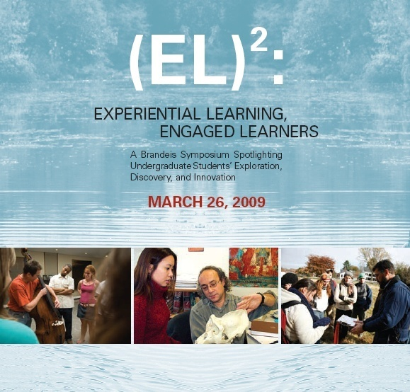
A Few Posters from Last Year
Last year’s official program

Slide 20
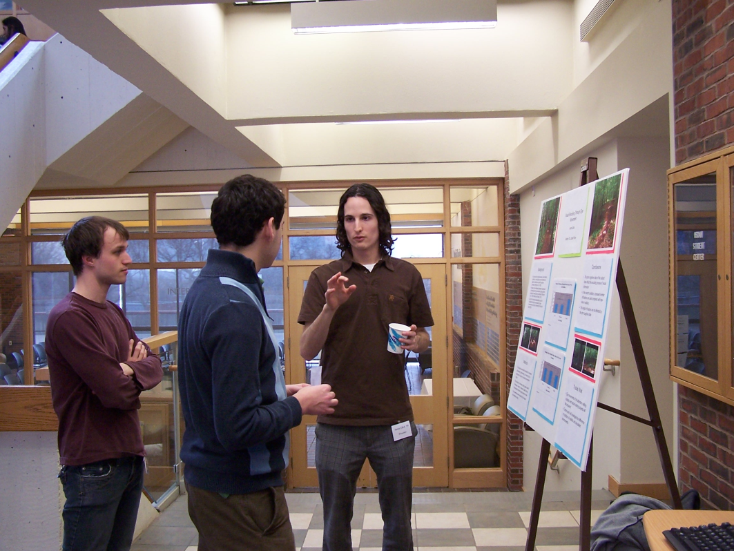
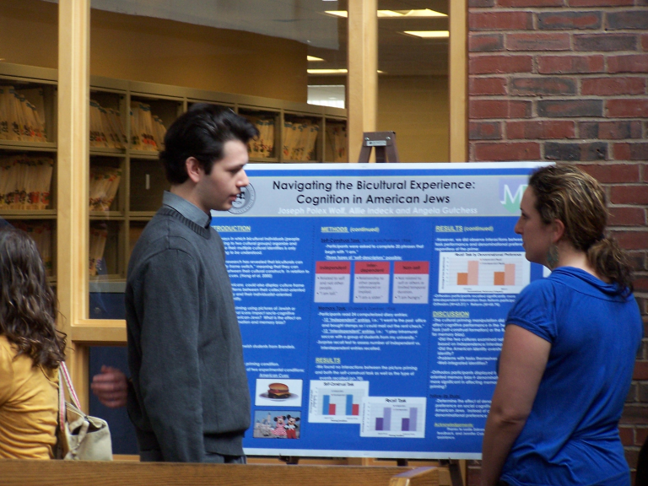
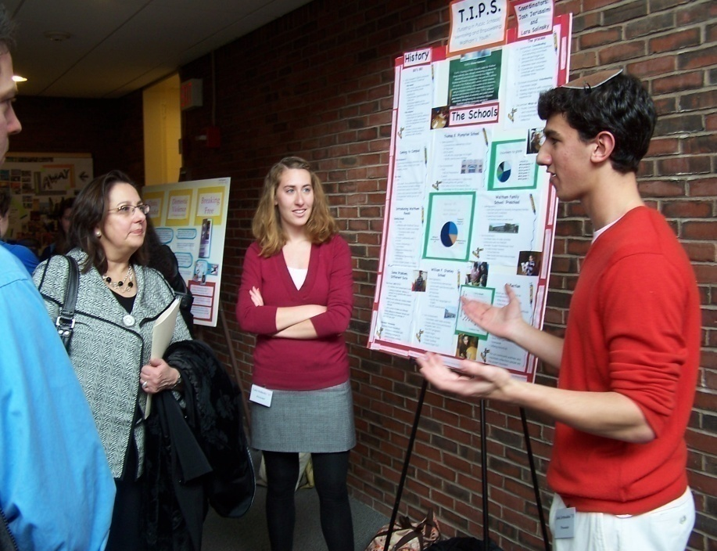
Students present their posters during the poster session.

Slide 21
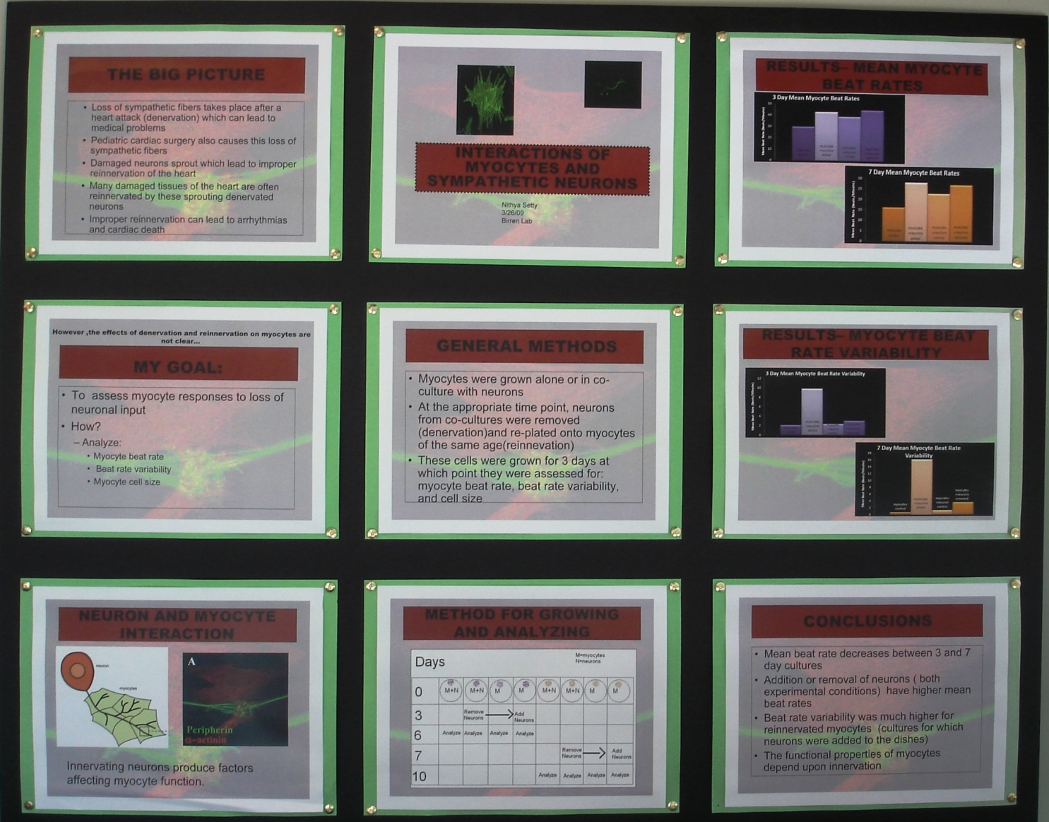
Clear sections
Colorful
borders
Clean and
easy to read
Not too
overwhelming
Interesting
graphics
“Grabbing”
Keywords
The Effect of Denervation and Reinnervation of Sympathetic Neurons on Myocytes
Nithya Setty, ‘09, BIO

Slide 22
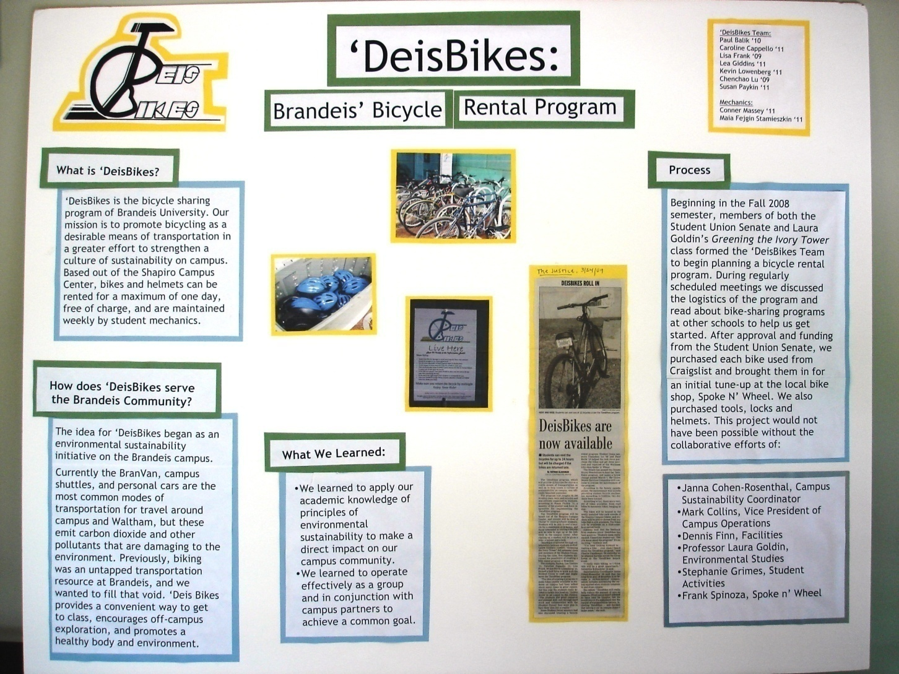
Simple
design
Colorful/
use of
contrasting
colors
Basic but
important
Sections
(What We
Learned)
Supporting
graphics
Newspaper
article
‘Deis Bikes: Brandeis Bicycle Rental Program
Caroline Cappello, ‘11, THA, Chenchao Lu ‘09, BIO & ECON, Lea Giddens, ’11, IGS,
Lisa Frank ‘09, POL, Paul Balik ‘10 POL, Susan Paykin, ‘11, IGS

Slide 23
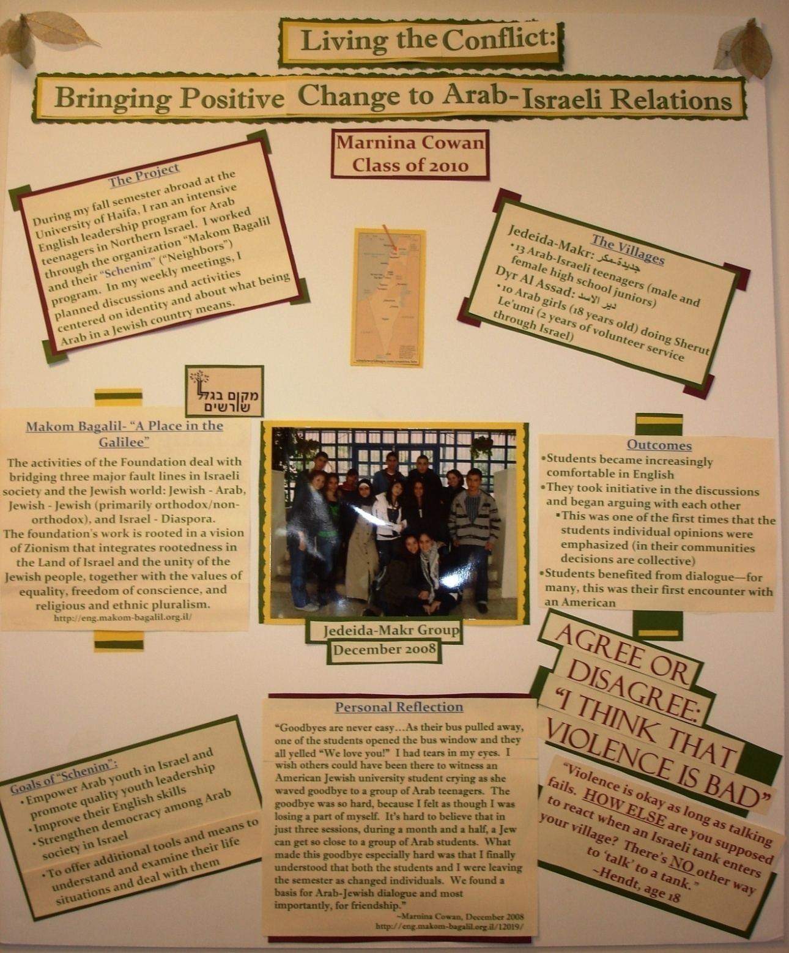
Artistic borders
Personalized title
Quotations
Colorful
Impactful sections:
  Personal Reflection
  Goals
  Outcomes
Living the Conflict: Bringing Positive Change to Arab- Israeli Relations in Israel
Marnina Cowan, ’10, IGS & HBRW

Slide 24
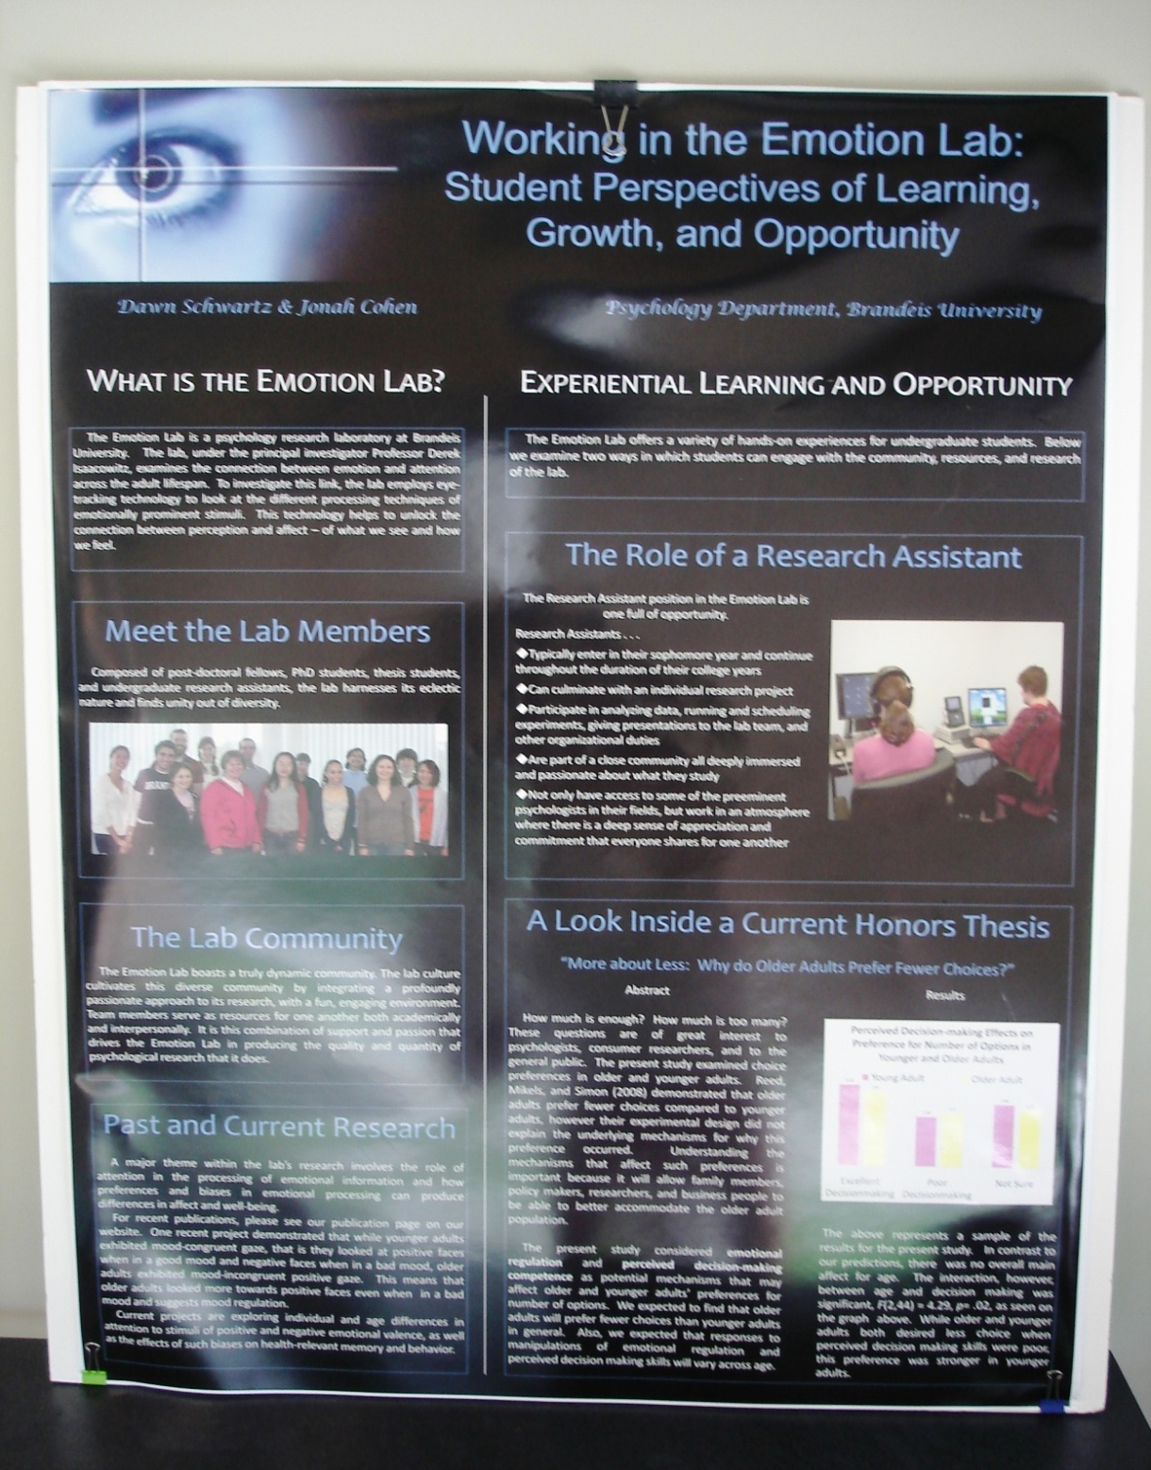
Professionally printed
Graphics with title
Catching title
Clear sections and
results
Good use of photos &
graph
Clear & easy to read
Sections are bordered
Life in the Emotional Lab: Two Student Perspectives
Dawn Schwartz ’09, PSYC & Jonah Cohen ’10, PSYC

Slide 25
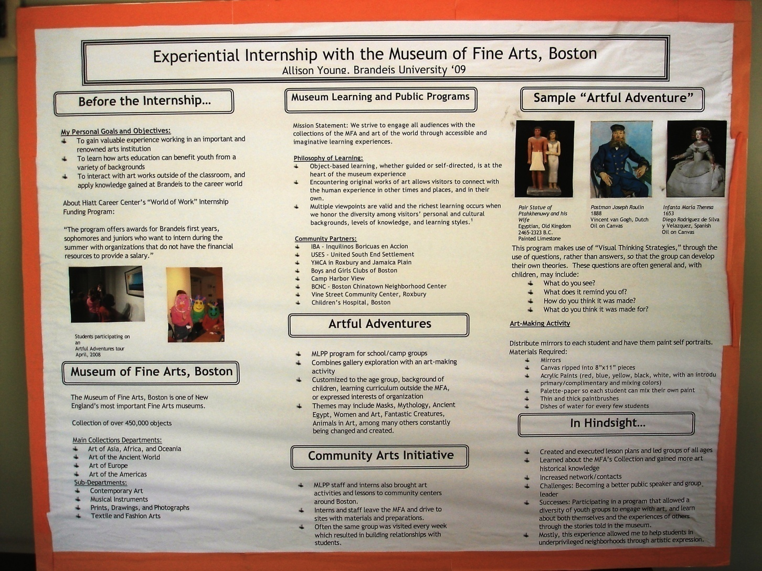
Border around
poster =
contrasting
color
Bordered
sections
Bullets instead
of sentences
Creative
section titles:
-In Hindsight
-Samples
Internship with the Museum of Fine Arts, Boston
Allison Young, ’09, FA & ANTH

Slide 26
(EL)²
Experiential Learning,
Engaged Learners
March 18th, 2010
What will your symposium poster look like?

Slide 27
(EL)²
Experiential Learning,
Engaged Learners
March 18th, 2010
Apply now!
Rolling applications;
notifications in October & February
Questions? experientiallearning@brandeis.edu
You’re experienced, but are you engaged?

