Slide 1
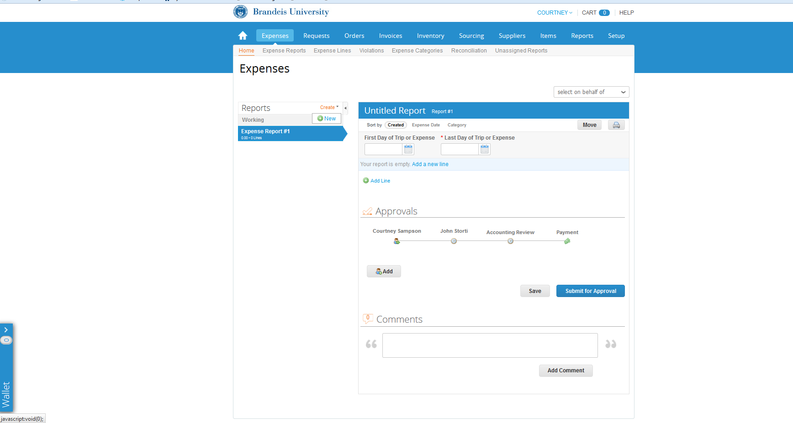
Creating an Expense Report
To begin, select Expenses and then select Create and select New from the drop down menu.
Select on behalf of drop down, when creating or updating an expense report on behalf of another user.
Your Wallet is where your receipts are stored until they are associated to a transaction
Notes:
Create a new, add line. Other expense reports are p-card reconciliations

Slide 2
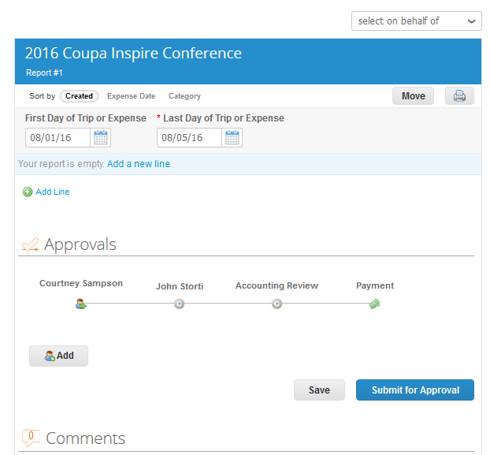
Creating an Expense Report
Next, rename your Untitled Report to a description of the trip or expense, then fill in the First and Last day of Trip or Expense, and select Add Line.

Slide 3
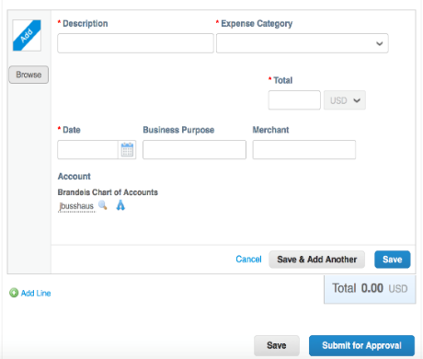
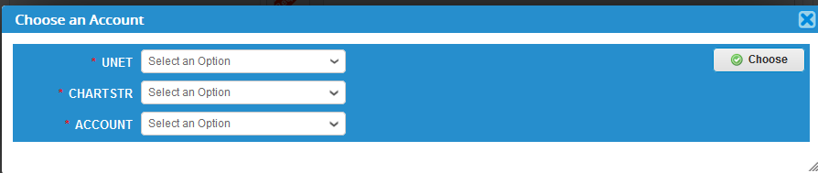
Creating an Expense Report
Once you have selected Add Line, the fields seen at left will appear.
At this time you may add in a Description of the Expense, and select an Expense Category from the drop down menu.
Input the dollar amount of the expense under Total, and then fill in the Date, Business Purpose and Merchant (if applicable).
Select the Magnifying Glass Icon or the Split Icon* next to Account to enter your Unet, Chartstring and Account for the transaction
Once you are done you can Save or Save & Add Another Line
* you can split by percentage or Amount

Slide 4
Expenses: Receipts
Users can easily upload receipts directly to MarketPlace+ in the following ways
  Send receipts to your Wallet (pdf, png, jpg, xls, doc, ppt., etc)
    Email receipts (as an attachment) to: expenses@brandeis.coupahost.com
    Drag saved receipts from your computer to your Wallet
    Receipts in your Wallet can then be dragged to the transaction you are working on.
  Use the Browse button next to the expense line and add a saved receipt from your desktop/computer.
  Use the Coupa App* and take pictures to associate receipts directly to the expense.
After all transactions are entered and receipts have been associated to those which require it, select Submit for Approval
* See our instructions on how to download the Coupa App

