Slide 1
INFORMATION SECURITY AWARENESS WORKSHOP
Information Technology Services
May 14, 2020

Slide 2
Agenda
Agenda
Welcome & Introductions
Evolving security threats in remote environment
  Zoombombing on the rise
  Phishing scams
  Viruses, viruses, and more viruses
Best practices while working remotely
Q&A
INFORMATION TECHNOLOGY SERVICES | SECURITY

Slide 3
Today’s Presenters
Today’s Presenters
Ravi Kotecha, Privacy & Information Security Analyst
Dan Jennings, Media & Computing Specialist
David Albrecht, Chief Information Security Officer
Contact ITS Security: security@brandeis.edu
Report Phishing: phishing@brandeis.edu
INFORMATION TECHNOLOGY SERVICES | SECURITY

Slide 4
Protect Your Zoom Meetings
Protect Your Zoom Meetings
Zoomboming, a new threat
  Uninvited guests show up to Zoom meetings
  Share content with inappropriate content
  Vulgar speech
Preventative Measures
  Security settings when scheduling meetings
  Security settings within meetings
  Be mindful of where your Zoom links are posted
    If publishing online, require registration, perhaps with a Google form
    Assume any link on a website or public social media account will have an uninvited visitor
INFORMATION TECHNOLOGY SERVICES | SECURITY

Slide 5
Secure Zoom Meetings When Scheduling
Secure Zoom Meetings When Scheduling
Enable waiting rooms for meetings
  Allows you to admit individual meeting participants into your meeting at your discretion
Don’t use personal meeting ID for public meetings
  For public meetings, you should always schedule new meetings with randomly generated meeting IDs
Require a password to join a meeting
  Feature can be applied to both your Personal Meeting ID, and to newly scheduled meetings.
Only allow registered or domain verified users
  You can require meeting attendees to register ahead of time, or restrict meetings to only allow Brandeis users to join

Slide 6
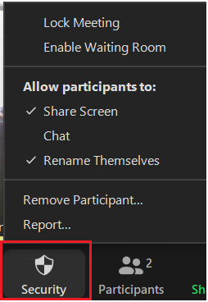
In-Meeting Security Settings
In-Meeting Security Settings
As meeting host, you have access to the Security menu within the meeting
From the Security menu, you can:
  Lock the meeting
  Enable waiting room
  Enable/Disable meeting participants from
  sharing screen, accessing chat, and renaming
  themselves
  Remove participants
INFORMATION TECHNOLOGY SERVICES | SECURITY

Slide 7
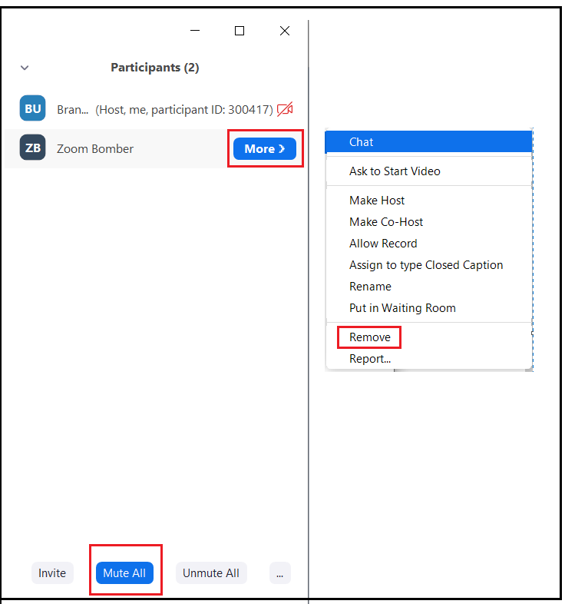
What do to if Zoombombed?
What to do if Zoombombed?
Identify and remove the participant.
Lock the meeting or enable waiting room from the security menu.
Disable screen sharing from the security menu.
Mute all participants from the participants tab.
Still having trouble?
End the meeting and report the meeting ID to ITS, (help@brandeis.edu or 781-736-4357).
INFORMATION TECHNOLOGY SERVICES | SECURITY

Slide 8
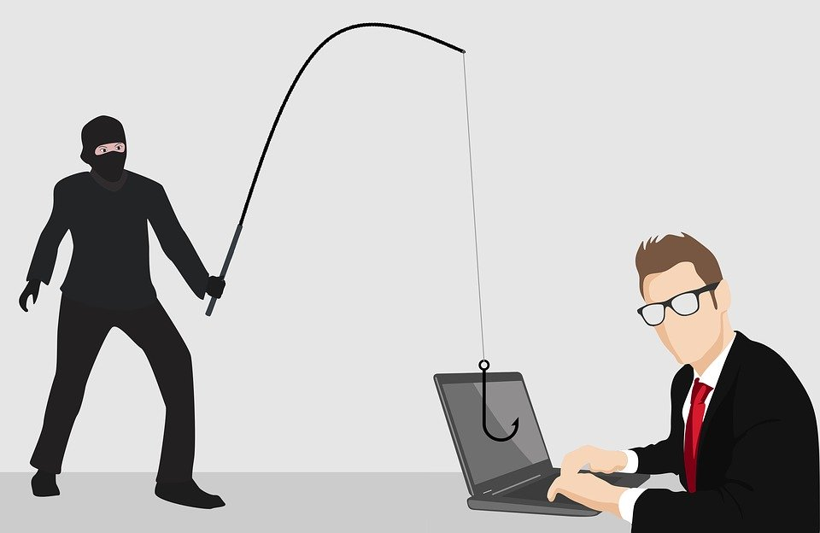
Avoid Phishing Scams
Avoid Phishing Scams
What is phishing?
  Seemingly trustworthy adversary solicits information
    Beware of impostors!
  Typically seen in email, phone calls, and texts
With the COVID-19 pandemic, we have seen a rise in phishing attempts
INFORMATION TECHNOLOGY SERVICES | SECURITY

Slide 9
Identifying Phishing Scams
Identifying Phishing Scams
Be on guard. If you don’t recognize the sender, the message may be a phish.
Read between the lines. If the email contains unexpected spelling or grammatical errors, it's probably not a legitimate email.
Beware before you share. Never give away personal information such as passwords, credit cards, or social security number.
Look but don’t click. Recognize the links? Hover your mouse over any link(s). before clicking to review the web address. If the link address looks strange, don’t click it.
When in doubt, throw it out. Even if you know the source, if something looks suspicious, delete it and report it.
Report suspicious emails: phishing@brandeis.edu

Slide 10
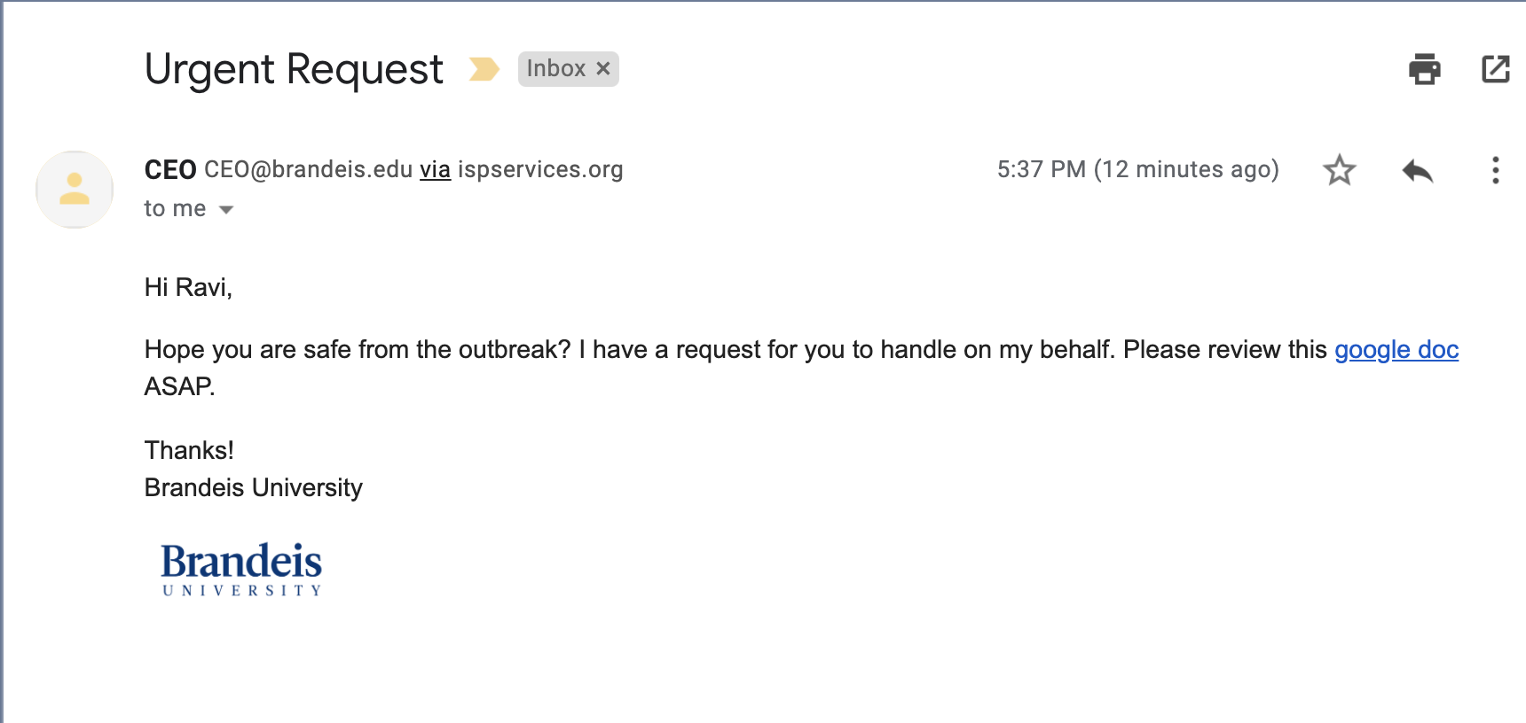
Phishing Example 1
Phishing Example
Subject to create sense of urgency
Email address in domain, but address could be spoofed
Hover over the link, where does it go?
Odd signature?
INFORMATION TECHNOLOGY SERVICES | SECURITY

Slide 11
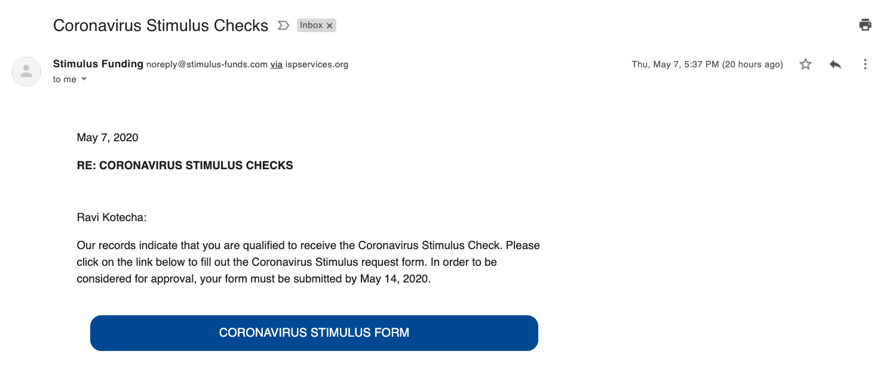
Phishing Example 2
Phishing Example
Subject to reel you in
Government emails will come from a .gov address
Deadline to create sense of urgency
Hover your mouse over the button to see where the link will take you.

Slide 12
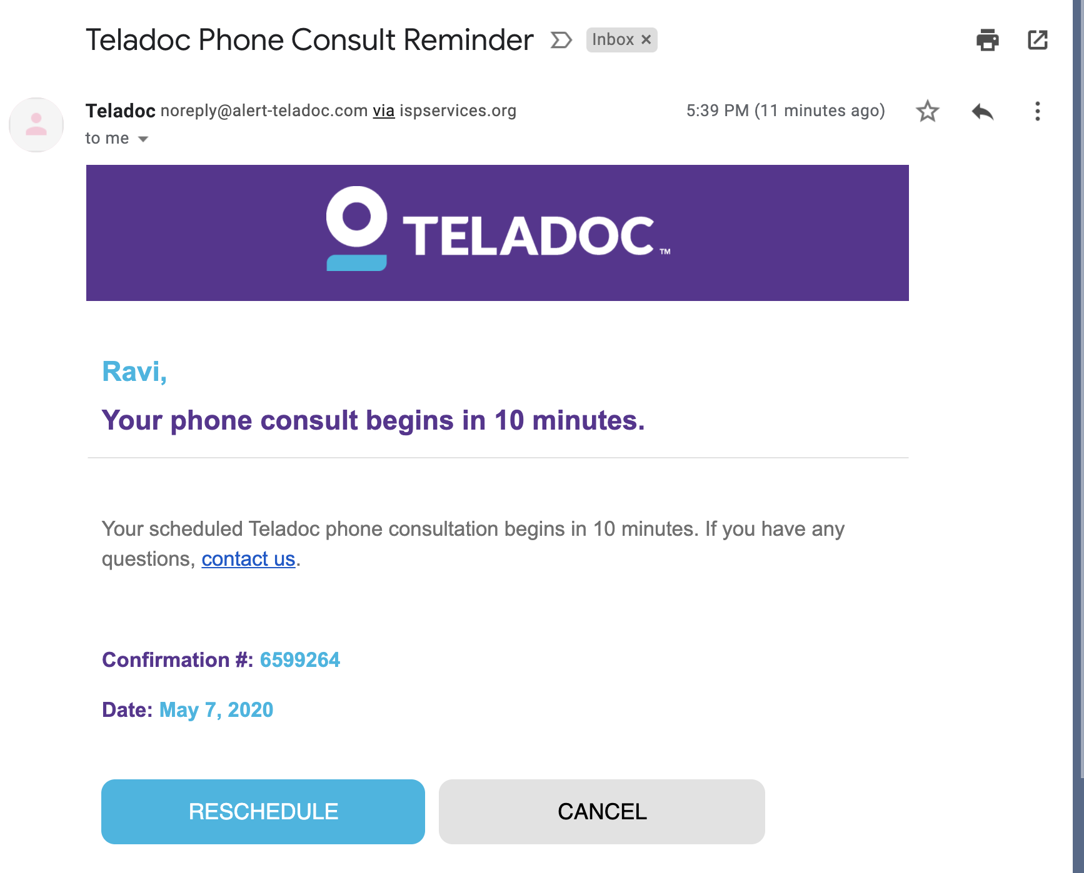
Phishing Example 3
Phishing Example
Do you normally receive these emails at work?
Notice the modified domain. “alerts-teladoc.com” is not the same as “teladoc.com”
Do you have an appointment?
If you do receive Teladoc emails at work, and have an appointment, go to the website directly to manage your account, and not through the provided links.

Slide 13

Securing Your Devices
Securing Your Devices
Install Operating System updates
  Desktop/Laptop: Windows, MacOS
  Mobile/Smartphone: Android, iOS
Install application updates when prompted
  Antivirus, Adobe products, Microsoft Office, Zoom
Get McAfee Anti-virus for home use
  brandeis.onthehub.com
INFORMATION TECHNOLOGY SERVICES | SECURITY

Slide 14

Securing Your Workplace
Securing Your Workplace
Secure your network
  Password protect WiFi Network
  Use Brandeis VPN (Pulse Secure) in unsecured locations
Protect your data
  Lock your computer screen
  Adopt a “clean desk” policy, storing your computer and any sensitive documents
  in a secure location
  Separate work and personal use
INFORMATION TECHNOLOGY SERVICES | SECURITY

Slide 15
Collaborate Securely
Collaborate Securely
Share files via approved channels
  Google Drive, Docs, Sheets, Slides (not suitable for sensitive information)
  Box
  Files.brandeis.edu file share, requires VPN
Share passwords via LastPass Enterprise
  LastPass is a password manager that stores your passwords in a vault
  Enroll at go.brandeis.edu/lastpass
  Emailing passwords is insecure
INFORMATION TECHNOLOGY SERVICES | SECURITY

Slide 16
Accessing Sensitive Information
Accessing Sensitive Information
Avoid accessing sensitive information (SSNs, credit card numbers, etc.) on personal devices or in public places
  Use VPN (Pulse Secure) to access these types of data on Brandeis systems
Sensitive data should only be shared via Box (brandeis.box.com) or files.brandeis.edu server
  Email, Google Drive, Dropbox or any other service should not be used for these kinds of data
Delete any sensitive data from your computer if unneeded, and remove from cloud storage if no longer in use
  Don’t forget to empty the Recycle Bin / Trash!
INFORMATION TECHNOLOGY SERVICES | SECURITY

Slide 17

Learn More
Learn More
Learn internet security and best practices to protect you and your family from security threats at home
Partnered with KnowBe4 to provide home security course
  Access: www.knowbe4.com/homecourse
  Password: homecourse
Topics include
  password management
  online banking security
  avoiding malware
  home network security

Slide 18
Resources
Resources
ITS Security website
  go.brandeis.edu/security
Understanding Security Tools
  www.brandeis.edu/its/services/information-security/understanding.html
  Google search -> Brandeis Security Tools
Protect Your Zoom Meetings
  www.brandeis.edu/its/services/communication/zoombombing.html
  Google search -> Brandeis Zoombombing
Home Security Course
  www.knowbe4.com/homecourse
  Password: homecourse
Test your ability to spot phishing emails!
  Try Google’s phishing quiz: phishingquiz.withgoogle.com/
INFORMATION TECHNOLOGY SERVICES | SECURITY

Slide 19
Questions
Questions?
security@brandeis.edu

