Slide 1
Proofpoint: Getting Started with Email Protection
Information Technology Services
January 2021

Slide 2

Agenda
Agenda
Welcome & Introductions
Email Protection Basics
Email Digest
Web Digest
INFORMATION TECHNOLOGY SERVICES | SECURITY

Slide 3
Today’s presenters
Today’s Presenters
Jade Fitzgerald, Senior Security Engineer
Ravi Kotecha, Privacy & Information Security Analyst
Contact ITS Security: security@brandeis.edu
INFORMATION TECHNOLOGY SERVICES | SECURITY

Slide 4
What is Proofpoint
What is Proofpoint?
Enhanced email security protection
  Spam protection
  Virus & malware protection
  Protection from phishing scams
  Bulk mail filtering
INFORMATION TECHNOLOGY SERVICES | SECURITY

Slide 5
What is Proofpoint-Benefits
What is Proofpoint?
Benefits
  Gives you control over what reaches your mailbox with several spam filtering options and the ability to create your own blocked and safe senders lists. We're putting the power right in your hands.
  You'll get daily notification emails showing you messages that have been flagged as spam, as well as options to block or allow senders, or specific emails. We make it easy for you to get the information you need.
  Allows you access to a web portal to view quarantined messages, manage sender lists, and manage account settings.
INFORMATION TECHNOLOGY SERVICES | SECURITY

Slide 6
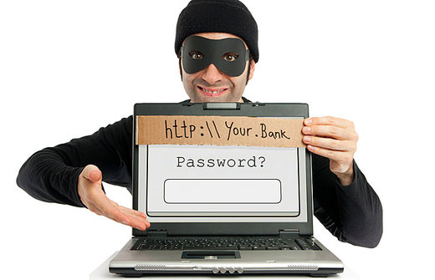
Bulk vs. Spam
Bulk vs. Spam
Spam Emails
  Generally malicious
  Includes phishing and other scams
Bulk Email
  What most think of as spam
  Marketing / Vendor emails
  Mass mailings
INFORMATION TECHNOLOGY SERVICES | SECURITY

Slide 7
How does it work?
How does it work?
Sits between internet and inbox
  Works with google to provide stronger email security
Email Digest will be received around 8 a.m. ET daily.
  List of emails filtered will be shown
  Can release emails directly from digest
Web Digest
  Allows finer control of email filtering
  Manage allowed and blocked senders
  Enable Bulk mail filtering (optional)
INFORMATION TECHNOLOGY SERVICES | SECURITY

Slide 8
Demo
Demo
Email digest
Web digest
INFORMATION TECHNOLOGY SERVICES | SECURITY

Slide 9
Resources
Resources
ITS Security website: go.brandeis.edu/security
Proofpoint how-to-guides, video tutorials, and FAQs: go.brandeis.edu/proofpoint
Web Digest: portal.proofpoint.com
INFORMATION TECHNOLOGY SERVICES | SECURITY

Slide 10
Questions
Questions?
security@brandeis.edu
INFORMATION TECHNOLOGY SERVICES | SECURITY

