Slide 1
Brandeis University
Mathematics Department
Undergraduate Curriculum and Advising Event
April 2024

Slide 2
Spring Events
Research talks by faculty (today at 12:15pm, Goldsmith 300)
Graduation Celebratory reception (breakfast May 15th)
BBQ / Social (date TBD)
Be sure to follow the Math Department on Instagram!
(and answer Department survey)

Slide 3
Math Tutoring
Free drop-in tutoring for undergraduate math classes 5 days a week
Covering all classes Math00-Math299. Just show up to Goldsmith 200 during any of the scheduled times.
See the tutoring schedule for Spring 2024:
Monday-Thursday 4pm-6pm + Fridays from 12pm – 2pm.

Slide 4
Mathematics Mentoring Program
The mission of the Brandeis Mathematics Mentoring Program is to help students successfully navigate the undergraduate program in Mathematics at Brandeis, and make it as inclusive as possible. https://www.brandeis.edu/mathematics/undergraduate/mentor-program.html
Weekly meetings Spring semester

Slide 5
DEI initiatives
The Math Department is committed to fostering an inclusive community, bringing together individuals from diverse backgrounds to celebrate and expand the power of mathematical thinking. https://www.brandeis.edu/mathematics/docs/diversity-statement.html
DEI Actions: https://www.brandeis.edu/mathematics/dei/index.html
New Outreach Opportunity: Online Tutoring Program starting in Spring 2024 https://tinyurl.com/AshlandBrandeisTutoring

Slide 6
Graduate Reading Program
Each semester, the Graduate Reading Program (GRP) pairs undergraduate students with graduate student mentors to undertake independent study projects. https://www.brandeis.edu/mathematics/undergraduate/directed-reading-program.html
Any sophomore, junior, or senior who has taken 15A (Linear Algebra) and 20A (Multi-Variable Calculus) is eligible to apply. No course credit given.

Slide 7
Putnam Exam : the Art of Problem Solving
The Putnam Exam is a Mathematics Competition for all undergrad math students and students from other disciplines in the US and Canada. The competition takes place annually on each university campus on the first Saturday of December.
https://www.maa.org/math-competitions/putnam-competition
We offer some relaxed, convivial, pizza-endowed, training sessions each fall.
If you like mathematical challenges and beautiful problems, we encourage you to participate in these meetings.
The training will be conducted by Professor Kiyoshi Igusa, and PhD candidate Tudor Popescu.

Slide 8
Textbooks
The Math Department keeps the current semester’s textbooks in Goldsmith 200 for you to view.
Textbooks are also placed on reserve in the library whenever possible.

Slide 9
Degree Programs in Math
Bachelor of Arts in Mathematics
Bachelor of Science in Mathematics
Bachelor of Science in Applied Mathematics
Minor in Mathematics
Teacher Preparation Track
Combined BA/MA: A student must make an appointment with the Undergraduate Advising Head in the Department of Mathematics in order to add the BA/MA to his/her program. This must be done no later than May 1 preceding his/her final year of study on campus.
A student can declare a Major in Mathematics or a Major in Applied Mathematics but not both.
A student may declare a minor in Mathematics but not in Applied Mathematics.

Slide 10
Requirements for All Math Degrees
As part of completing any Math Major, students must:
Satisfy the Brandeis Core Requirements (see ”Notes” for listing of courses which fulfill these requirements).
One of: Math 15a (Linear Algebra) or 22a (Honors Linear Algebra)
One of: Math 20a (Multivariable Calculus) or 22b (Honors Multivariable Calculus)
Math 23b (Introduction to Proofs)

Slide 11
Checklist of Courses
We have course checklists to help you prepare your schedules: https://www.brandeis.edu/mathematics/docs/major-checklist.pdf
https://www.brandeis.edu/mathematics/docs/minor-checklist1.pdf

Slide 12
BA in Mathematics
As part of completing the BA in Math major, students must complete these courses with at least a grade of C- :
Satisfy the Brandeis Core Requirements.
One of MATH 15a or 22a; MATH 20a or 22b.
MATH 23b or exemption
MATH 35a, 110a, or 115a.
MATH 28a, 28b, or 100a.
Four additional semester courses, either MATH courses numbered 27 or higher or cross-listed courses in Mathematics.
No course taken pass/fail may count toward the major, honors, or the teacher preparation track

Slide 13
BS in Mathematics
As part of completing the BS in Math, students must complete these courses with at least a grade of C-
Satisfy the Brandeis Core Requirements
MATH 15a or 22a; MATH 20a or 22b
MATH 23b or exemption.
MATH 35a, 110a, or 115a.
MATH 28a, 28b, or 100a.
Seven additional semester courses, either MATH courses numbered 27 or higher or cross-listed courses in Mathematics.
No course taken pass/fail may count toward the major, honors, or the teacher preparation track

Slide 14
BS in Applied Mathematics
As part of completing the BS in Applied Math major, students must complete courses with at least a grade of C- :
Satisfy the Brandeis Core Requirements.
At least twelve semester courses are required, including the following:
Three foundational courses: Math 15a or Math 22a, Math 20a or Math 22b, and Math 36a.
Math 23b or an exemption.
Math 36b or Math 40a.
Two of the following analysis courses: Math 35a, Math 37a, Math 110a or Math 115a.
Two of the following: Math 121a, Math 122a, Math 123a, Math 124a, Math 125a or Math 126a.
(continued to next slide)

Slide 15
BS in Applied Math (con’t)
One additional mathematics course number 27 or higher or a course cross-listed in Applied Mathematics.
Two courses must be taken from another department from the following list: BCHM 102a, BCHM 104a, BCHM 145a, CHEM 141a, CHEM 142a, CHEM 146b, COSI 21a, COSI 112a, COSI 123a, COSI 130a, COSI 177a, COSI 180a, ECON 80a, ECON 161a, ECON 181b, ECON 182a, ECON 184b, NBIO 136b, NPHY 115a, any PHYS course numbered 20 or higher, and QBIO 110a.
No grade below a C- will be given credit toward the Bachelor of Science degree.
No course taken credit/no credit may count towards the Bachelor of Science degree.

Slide 16
How to Declare a Math Major
Study all the requirements for the major in the University Bulletin: https://www.brandeis.edu/registrar/bulletin/provisional/courses/subjects/4700.html
Fill out a Major/Minor Declaration Worksheet with a complete course plan for the major: https://www.brandeis.edu/registrar/forms/major-minor.html
Schedule an appointment with the Undergraduate Advising Head (UAH), Prof. Dmitry Kleinbock (kleinboc@brandeis.edu) to declare the major. Bring the filled out worksheet to the appointment or send by email.

Slide 17
How to be Assigned a Math Faculty Advisor
Go to the faculty list on the Math Department website, and pick a candidate professor that you would like to be your advisor. Note: faculty who are listed as “Instructors”, “Postdoctoral Associates/Fellows” or “Lecturers” do not generally act as advisors. https://www.brandeis.edu/mathematics/people/index.html
Discuss and decide on the advisor in the appointment with the UAH. Get the signature from the advisor on your Major/Minor Declaration Worksheet, and submit the worksheet, with the signature, to the UAH.

Slide 18
Undergraduate Department Representatives (UDRs)
Bhakti Parwani is a junior majoring in Math, Business and Economics.
Dakota Lichauco is a junior currently pursuing a degree in Computer Science with a minor in math and music.
Bhakti Parwani (bhaktiparwani@brandeis.edu)
Dakota Lichaucho (olivialichauco@brandeis.edu)

Slide 19
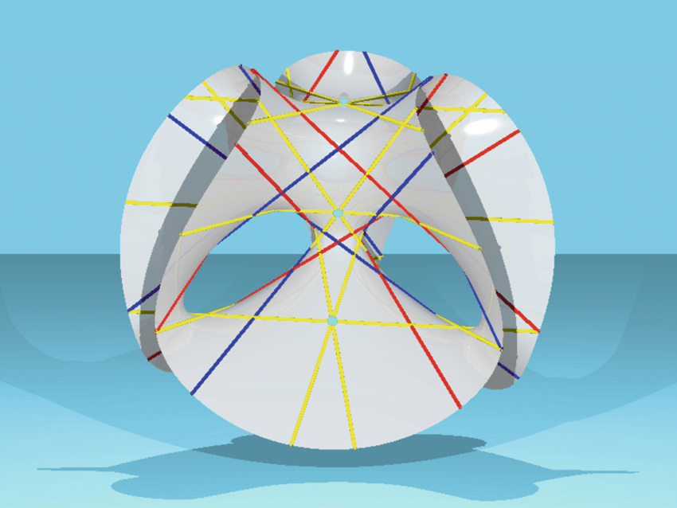
Questions and Answers thank you for coming!

Slide 20
Rotation of Courses
Math 3a | Explorations in Math: A Course for Educators | Every Year, Spring
Math 5a | Precalculus Mathematics | Every semester, Fall and Spring
Math 8a | Introduction to Probability and Statistics (qr,sn) | Every semester, Fall and Spring
Math 9a | Science and Science Fiction (sn) | TBD
Math 9b | Math Puzzles and Games | Every Year, Spring
Math 10a | Techniques of Calculus (a) (sn) | Every semester, Fall and Spring
Math 10b | Techniques of Calculus (b) (sn) | Every semester, Fall and Spring
Math 15a | Linear Algebra (sn) | Every semester, Fall and Spring
Math 16b | Linear Algebra Practicum (dl,oc) | Every Year, Spring
Math 20a | Multi-variable Calculus (sn) | Every semester, Fall and Spring
Math 22a | Honors Linear Algebra (sn) | Every Year, Fall
Math 22b | Honors Multi-variable Calculus (sn) | Every Year, Spring
Math 23b | Introduction to Proofs (sn,wi) | Every semester, Fall and Spring
Math 28a | Introduction to Groups (sn) | Every other year, Spring Even Years
Math 28b | Introduction to Rings and Fields (sn) | Every other year, Spring Odd Years
Math 31a | Advanced Linear Algebra (sn) | Every Year, Fall
Math 35a | Advanced Calculus and Fourier Analysis (sn) | Every Year, Fall
Math 36a | Probability (qr, sn) | Every Year, Fall
Math 36b | Mathematical Statistics (qr,sn) | Every Year, Spring
Math 37a | Differential Equations (sn) | Every Year, Spring
Math 39a | Introduction to Combinatorics (sn) | Every other year, Fall Odd Years
Math 40a | Introduction to Applied Mathematics (oc dl,sn) | Every Year, Fall
Math 47a | Introduction to Mathematical Research (sn,wi) | Every Year, Fall

Slide 21
Rotation of Courses (con’t)
Math 100a | Introduction to Algebra, Part I (sn) | Every Year, Fall
Math 100b | Introduction to Algebra, Part II (sn) | Every other year, Spring Even Years
Math 102a | Introduction to Differential Geometry (sn) | Every other year, Spring Odd Years
Math 104a | Introduction to Topology (sn) | Every other year, Fall Odd Years
Math 108b | Introduction to Number Theory (sn) | Every other year, Fall Even Years
Math 110a | Introduction to Real Analysis, Part I (sn) | Every Year, Fall
Math 110b | Introduction to Real Analysis, Part II (sn) | Every other year, Spring Even Years
Math 115a | Introduction to Complex Analysis (sn) | Every Year, Spring
Math 121a | Mathematics for Natural Sciences (sn) | Every Year, Spring
MATH/MUS | Math and Music (ca) | TBD
Math 122a | Numerical Methods and Big Data (dl, sn) | Every Year, Fall
Math 123a | Principles of Mathematical Modeling | Every other year, Fall Odd Years
Math 124a | Optimization (dl,sn) | Every other year, Spring Odd Years
Math 125a | Mathematics for Machine Learning | Every other year, Spring Even Years
Math 126a | Introduction to Stochastic Processes&Models | Every other year, Fall Even Years
Math 201a | Algebra I (sn) | Every Year, Fall
Math 201b | Algebra II (sn) | Every Year, Spring
Math 211a | Real Analysis (sn) | Every Year, Fall
Math 211b | Complex Analysis (sn) | Every Year, Spring
Math 221a | Topology I (sn) | Every Year, Fall
Math 221b | Topology II (sn) | Every Year, Spring
Math 225a | Geometry of Manifolds (sn) | Every Year, Fall

