Slide 1

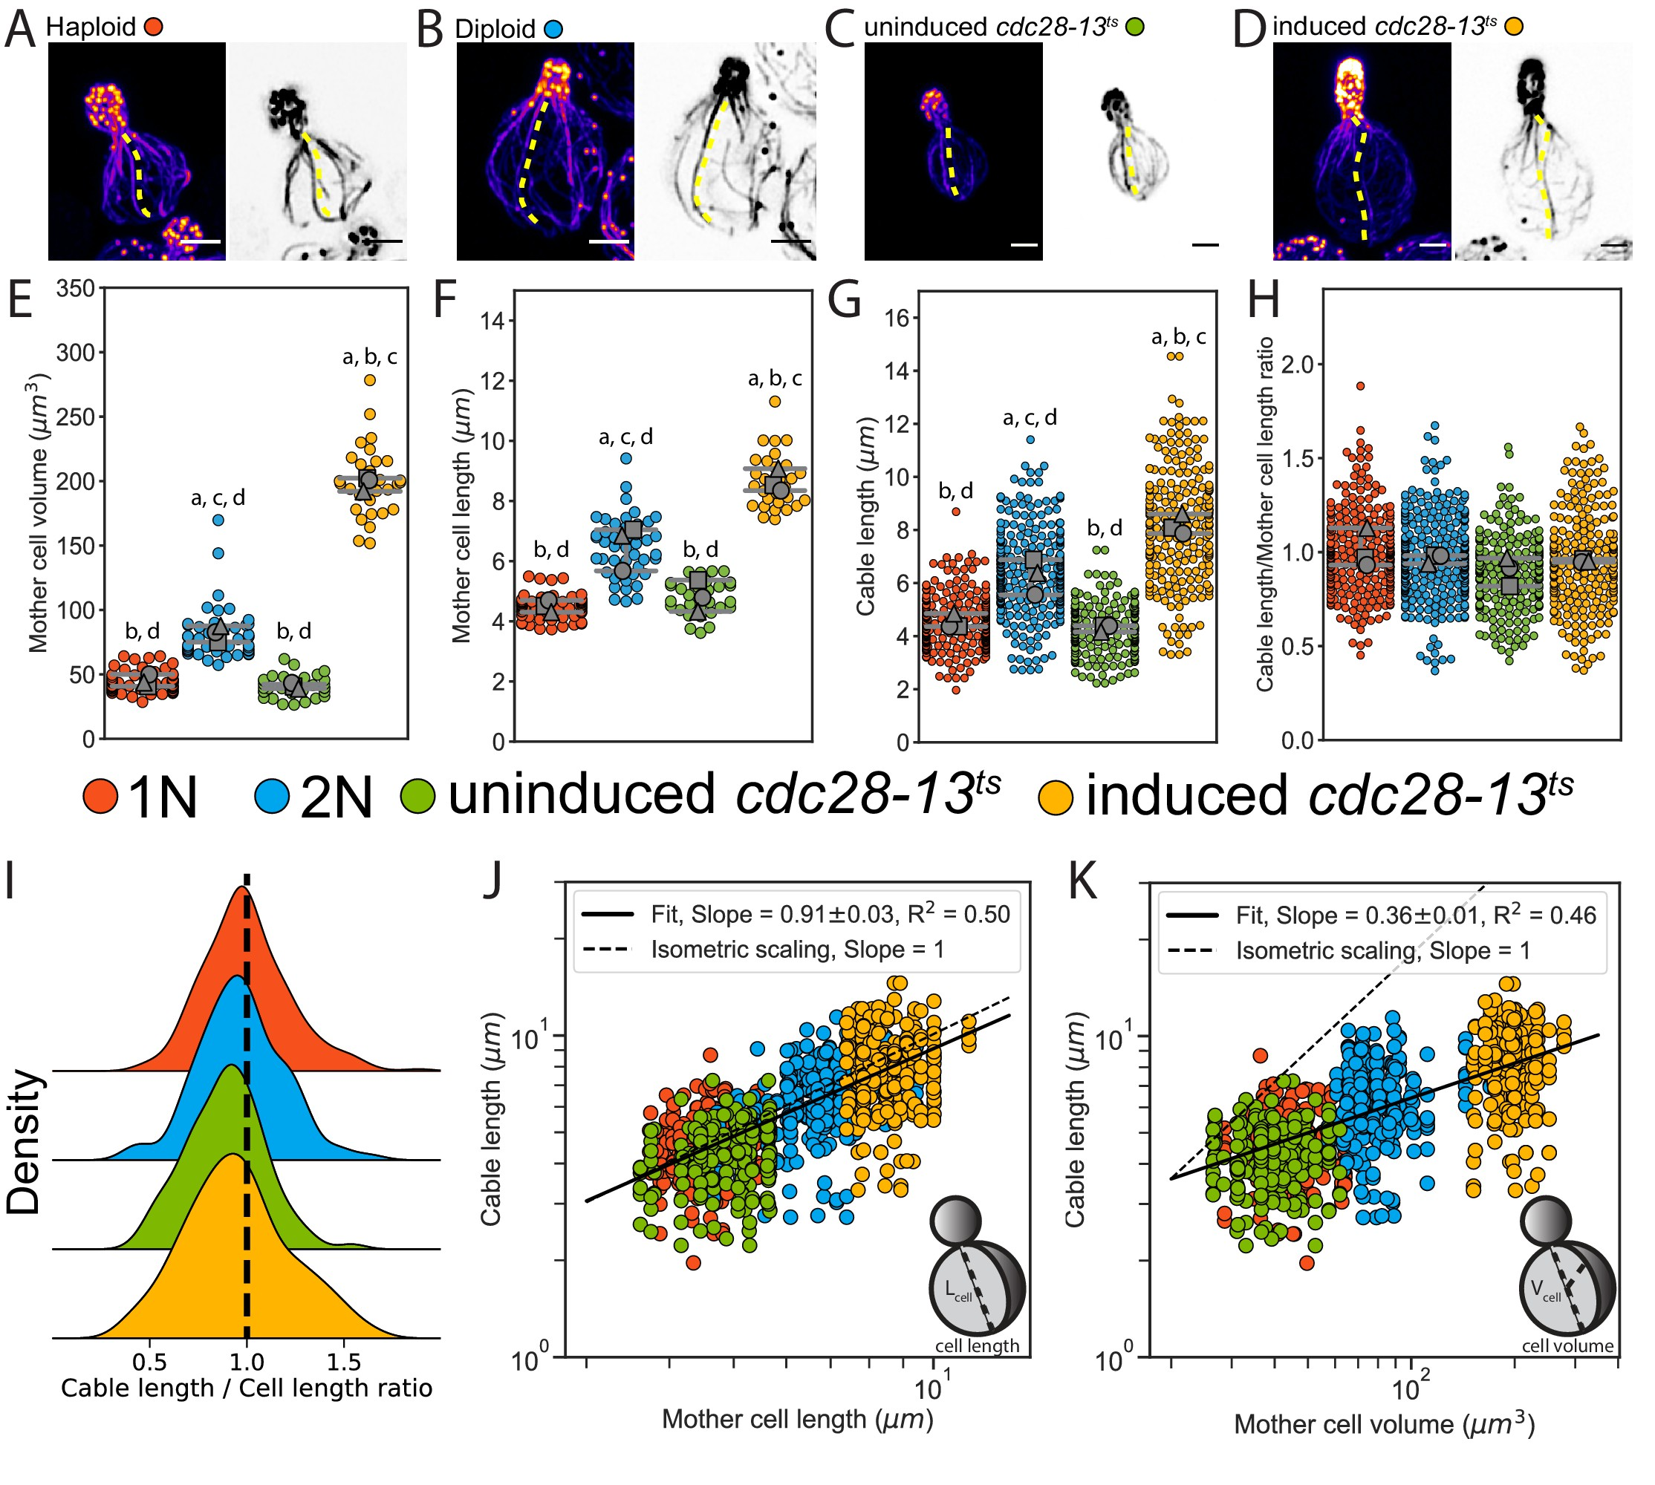
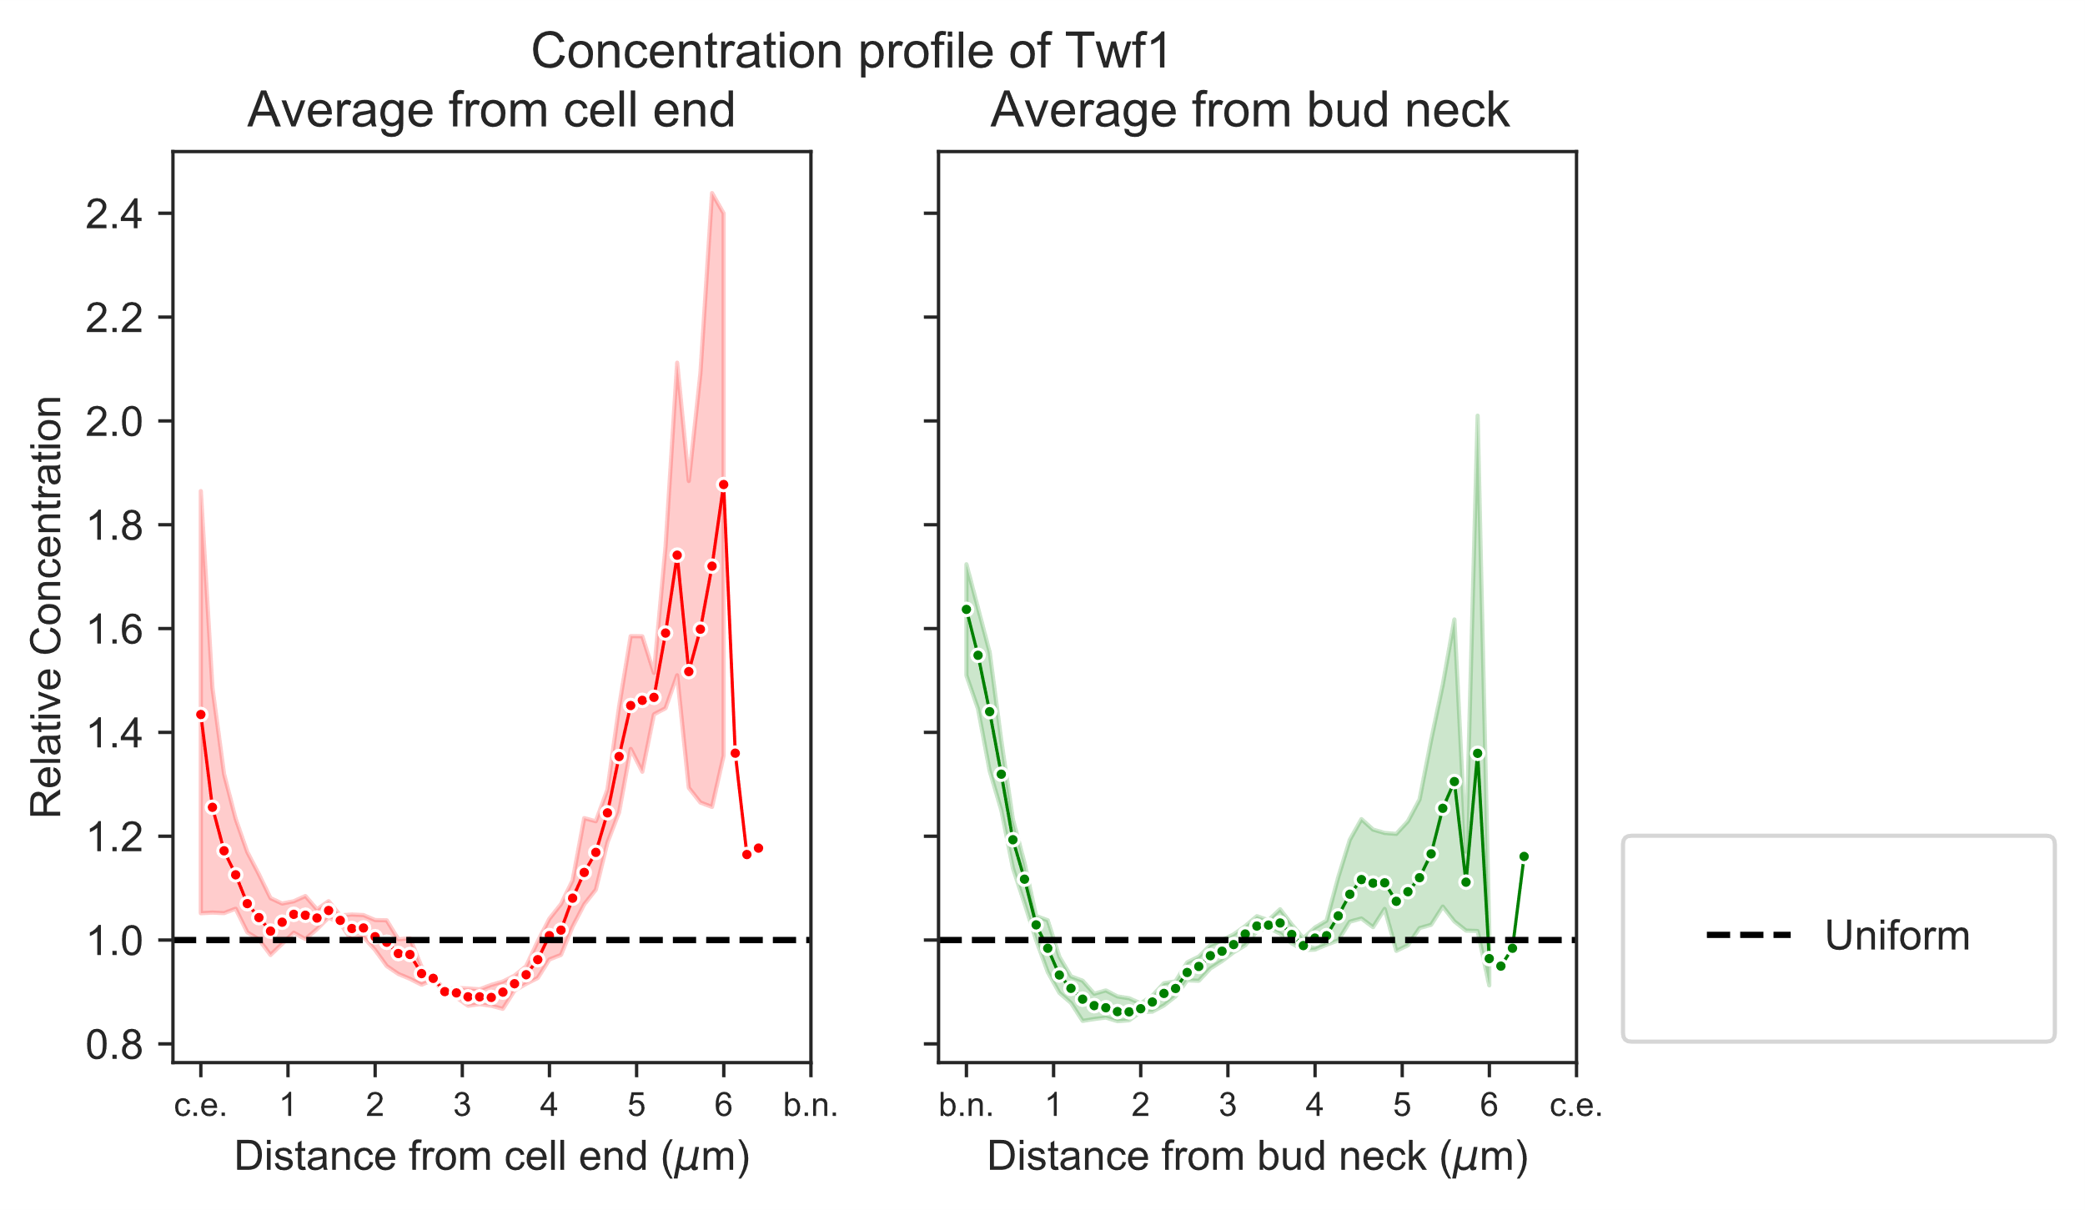
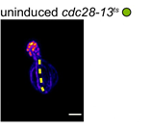
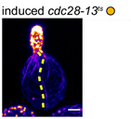
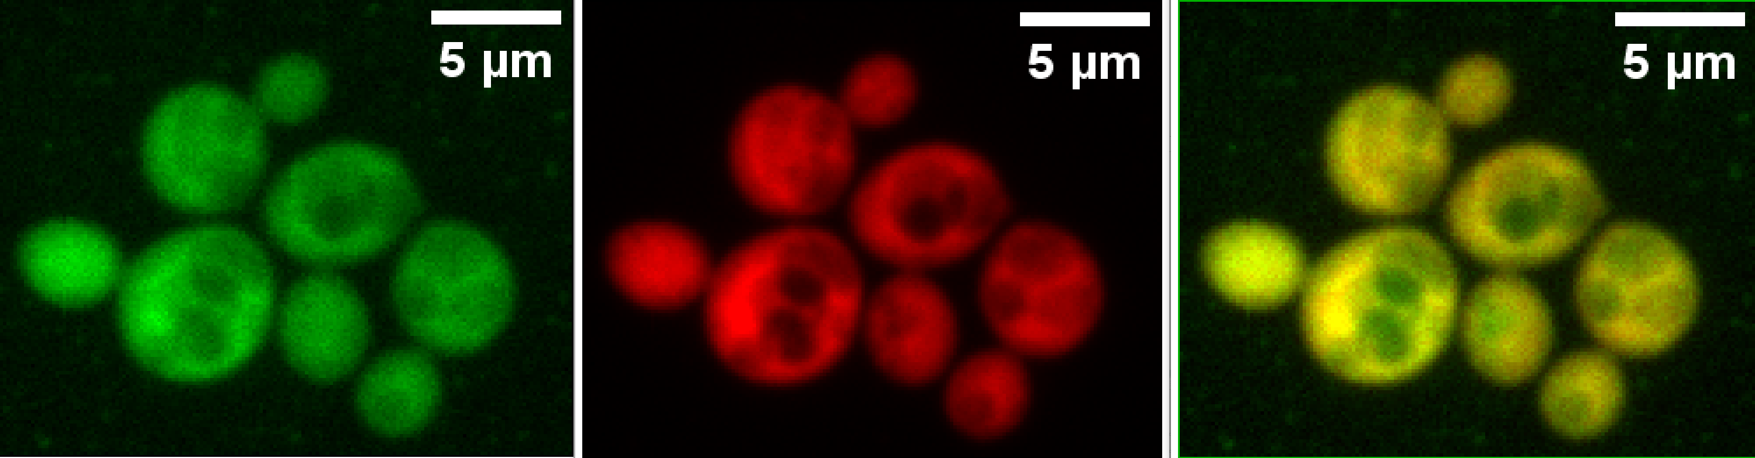
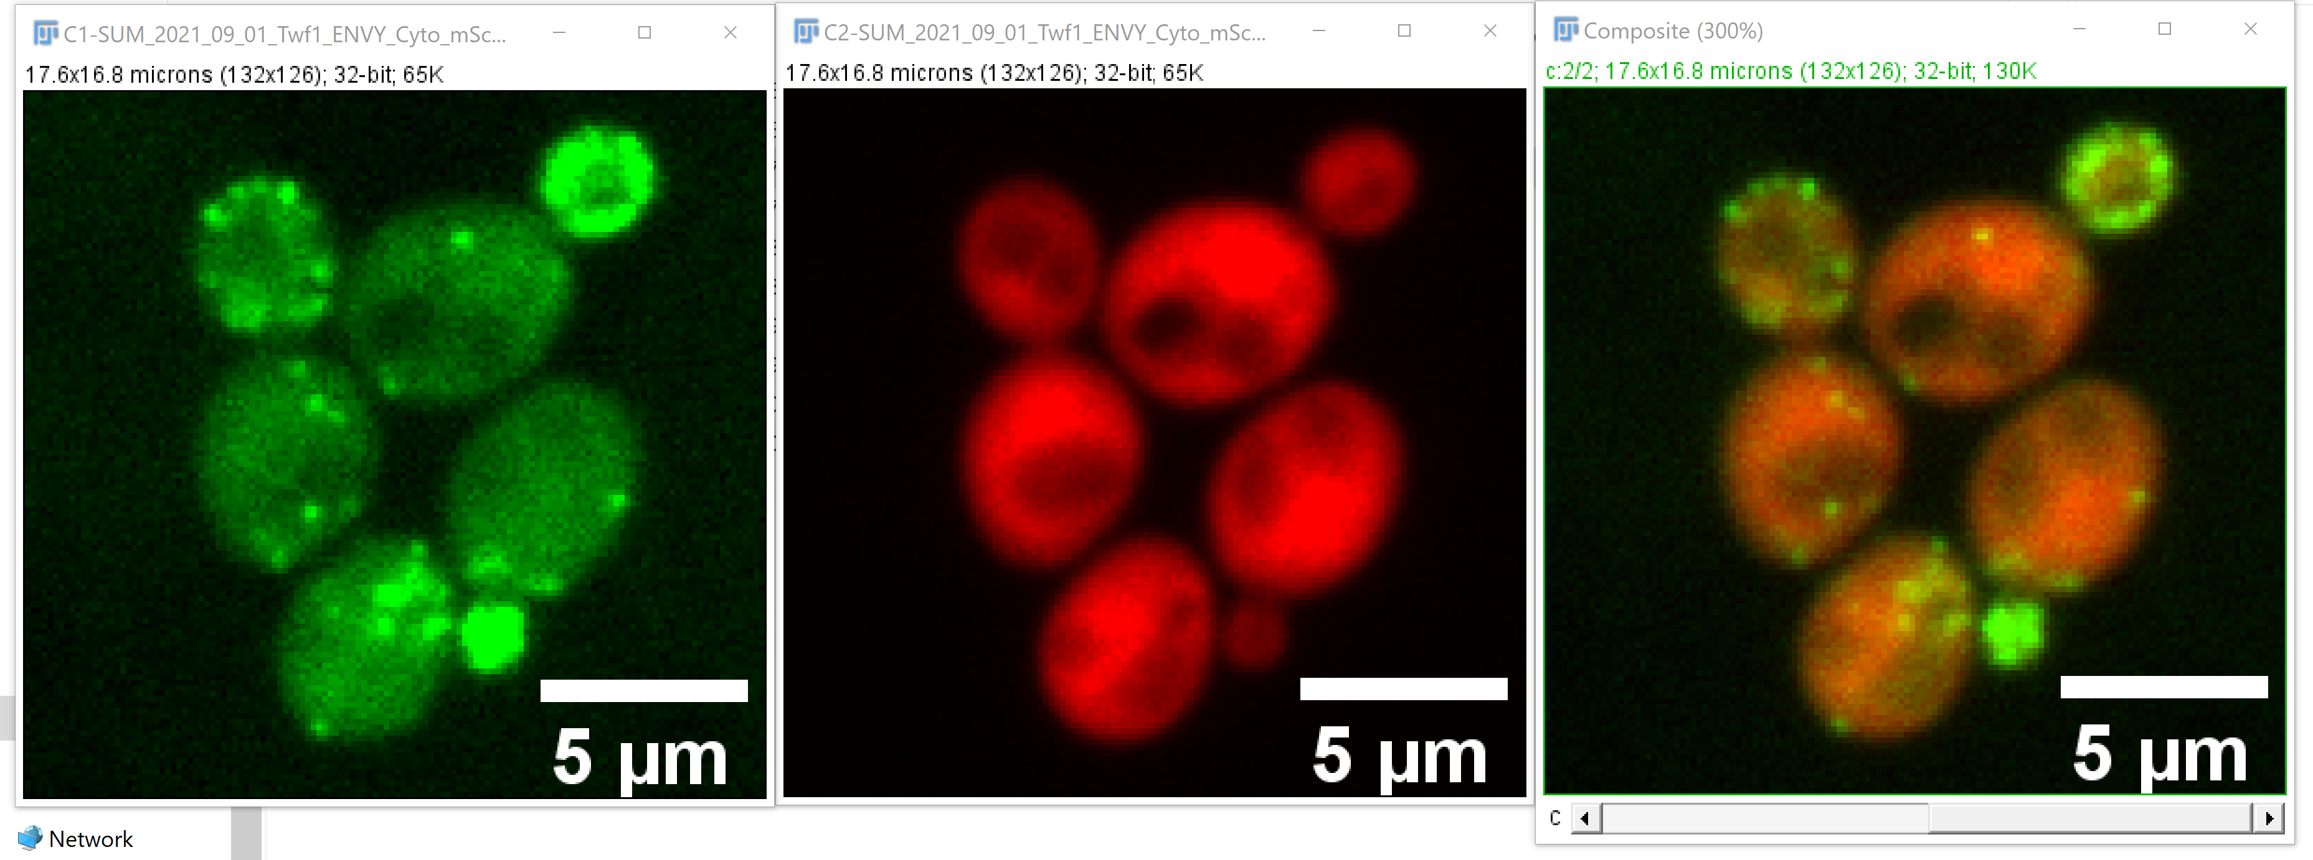
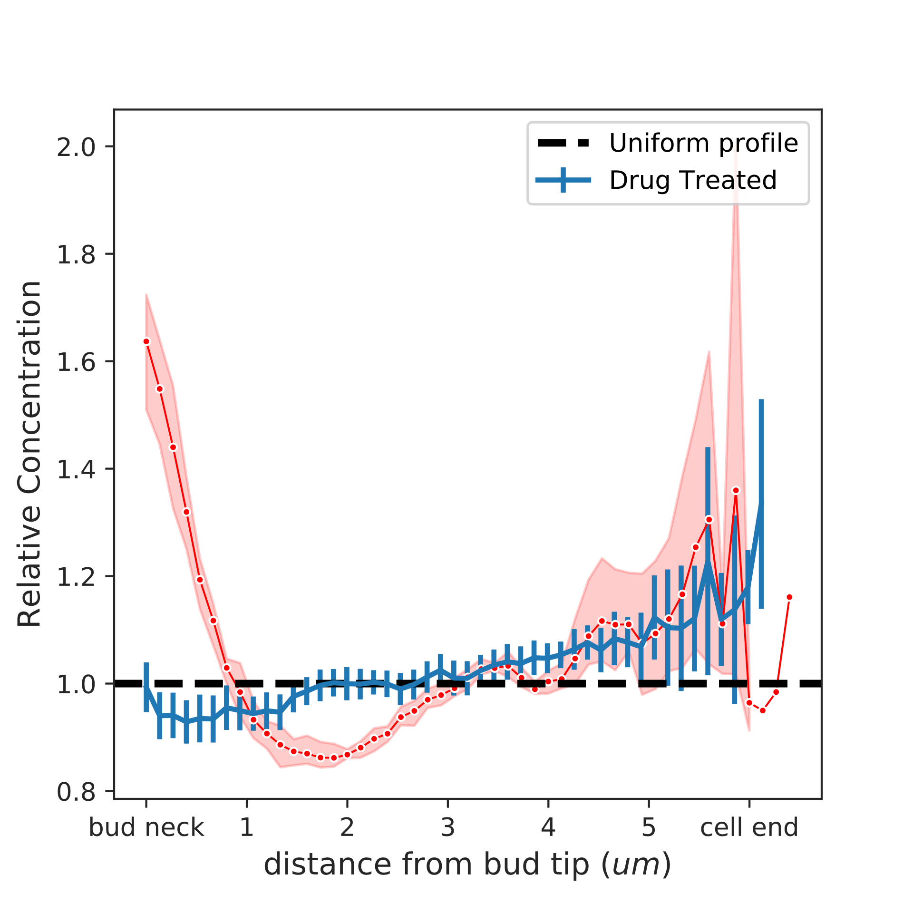
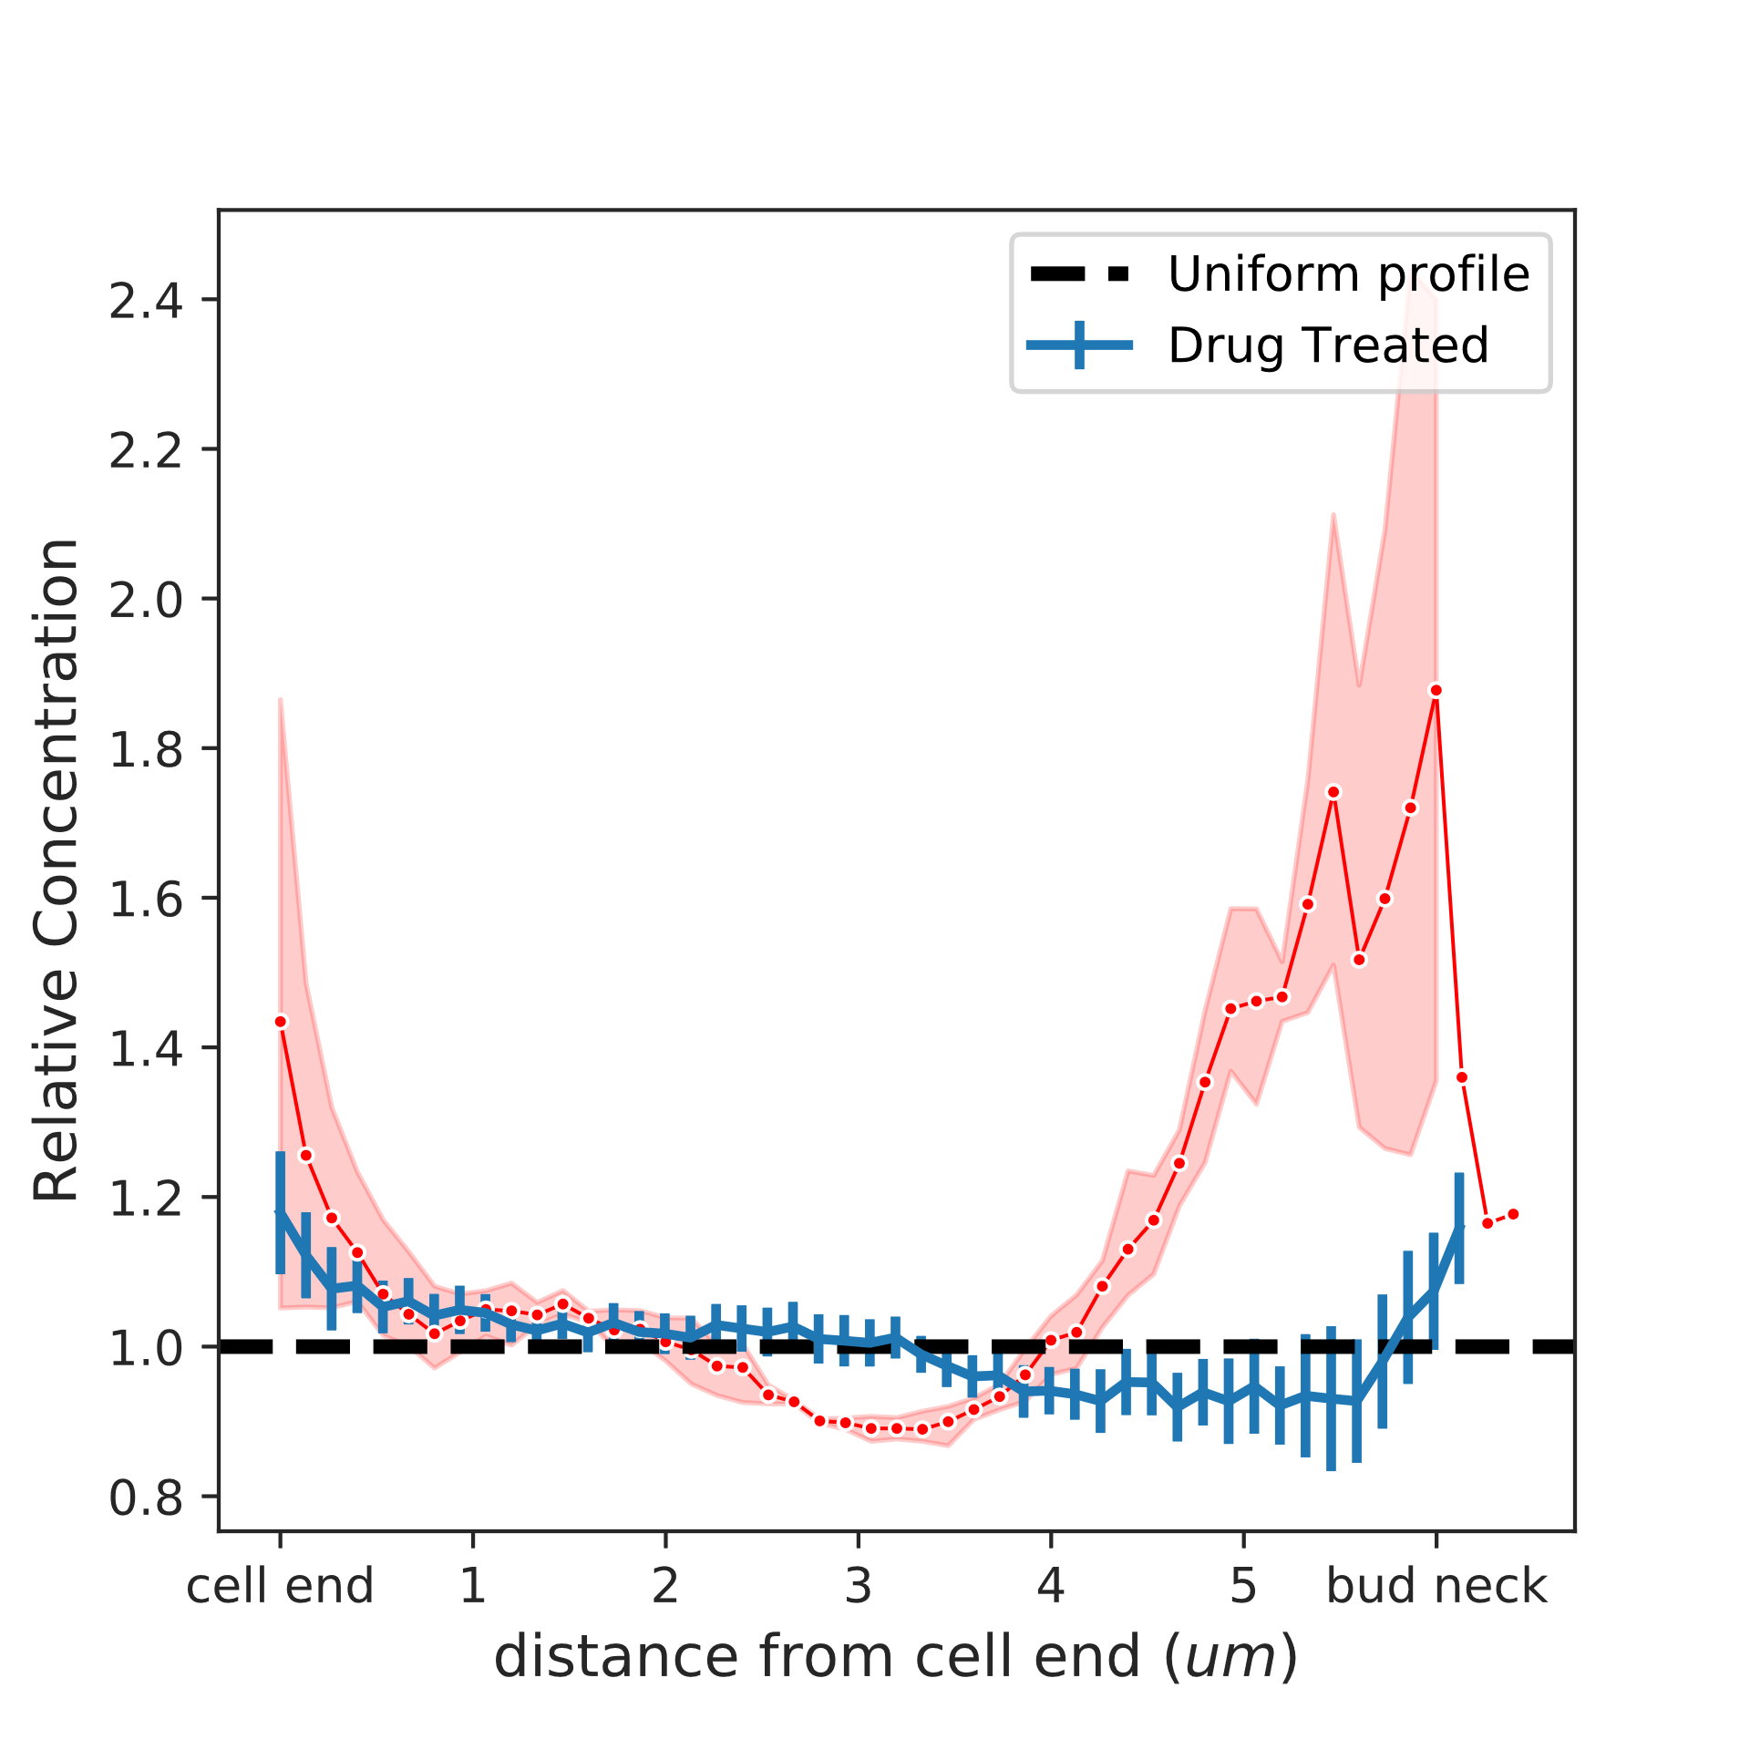
In search of protein gradients in budding yeast
Aldric Rosario, Jane Kondev, Bruce Goode*
Department of Physics, Brandeis University, Waltham, MA
* Department of Biology, Brandeis University, Waltham, MA
Introduction
Results
Future Directions
Actin cables in budding yeast grow to match their length to the length of the cell⁽¹⁾.
AAPs are enriched at the cell end and the bud neck.
Here I have shown that the actin associated proteins have a spatial distribution.
This distribution is dependent on the actin cytoskeleton of the cell.
Does this spatial distribution set up while the polarity of the cell is established?
Does this spatial distribution of AAPs scale with the length of the cell?
Actin cables start growing fast at the bud neck and then gradually slow down as they reach the end of the mother cell. We hypothesize that a gradient of depolymerizing proteins could be key for this length control.
Methods
Latrunculin-B is an actin monomer sequestering drug. When cells are treated with this drug, they lose all their actin structures (Here, actin patches and cables). In this case, the spatial distribution of the AAPs are altered
In cells, fluorescent tags are added by integration into the genome at the chromosomal level
References
Protein of interest
Cytosolic marker
McInally, S. G., et al, Elife 2021
An important aspect of Brandeis MRSEC is to create materials with specific size and properties. My research aims to clarify how cells do this!
Acknowledgments
I thank all members of the Kondev, and Goode labs for helping us with this research. We thank Shane McInally, Alison Wirshing, Neha Koundinya for all the discussion and help in building the yeast strains.
This research was conducted as a part of the Brandeis MRSEC.
To quantify the concentration of actin associated proteins inside the cell, protein of interest is tagged with GFP, and the cytosol of the cell is in RFP.
This lets us use a ratio metric analysis as a proxy for concentration.

