Slide 1
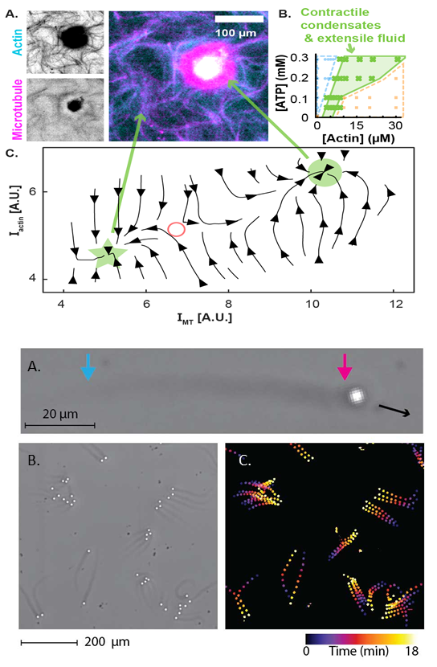
Development of new active materials
DMR MRSEC 2011486
2021
^{1,2}Z. Dogic ,¹G. Duclos, ¹S. Fraden and ¹B. Goode ¹Brandeis University, ²UCSB
Active materials are systems that are driven by nano scale components that consume energy and produce work. In this work, two new biochemically powered active materials were developed with unique properties that will allow for a systematic exploration of emergent non-equilibrium phenomenology.
The first system is an MT-Actin composite that provides independent control of active and passive stresses. This unprecedented control leads to novel nonequilibrium steady states including coexistence of contractile and extensile active materials in a single system. The second is an active material composed of beads that are propelled by actin polymerization. This motor-free biochemical active material provides the template to build a new class of active materials that leverage polymerization forces.
MT-actin composites (A) lead to novel states (B) that exhibit coexistence of extensile and contractile fluids (C)
Actin polymerization propels beads (A) which, when confined to flow chambers (B), exhibit collective motion

