Slide 2
Your Title Goes Here
Your Name, Other Person(s) on Project, Your PI
Date and Title of Conference/Presentation Event (for example 2021 UCRR Symposium)

Slide 3
Introduce your “problem” or what your main subject
Each slide’s title should be a sentence with a verb that summarizes your main point on that slide.
Start your presentation by introducing the “problem” you aim to solve or the main subject of your presentation. Remember to say why your audience should care or how it relates to your audience.
Start with a very broad introduction and aim to have only a couple thoughts shared per slide (you can have multiple introduction slides! – more about this on the next slide) then in the next slides you will dive in deeper.
You can edit the font, size, and color on slides.¹
You can have a “Main Questions” slide that has an explicit question ending in a “?”
1. If you have references for the information specifically on this slide, they should be listed here.

Slide 4
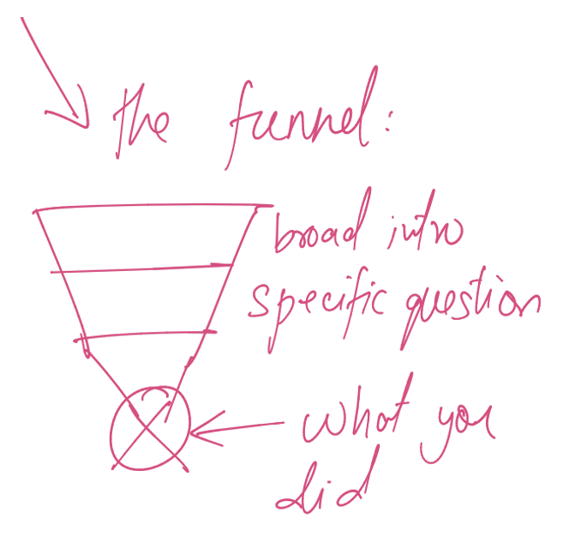
When you have multiple introduction slides, use the funnel method
The funnel method is starting with a broad introduction
  Next, you define the specific question
    After this, you describe what you did
1. If you have references for the information specifically on this slide, they should be listed here.

Slide 5
Methods
If applicable, describe the methods used in your work:
  Big blocks of text can be hard to read
  Bullet points might be useful here
  As always, a picture is worth a thousand words¹
    Also, its
1. If you have references for the information specifically on this slide, they should be listed here.

Slide 6
Results/Body of Presentation
Show the bulk of your presentation/your data with figures and tables; be sure to include figure legends and captions so your audience can understand what you tested, how, etc.
If your presentation includes videos, gifs, interactive figures, you can embed these in the template.
  Make sure your embedded items work offline
If you have graphs, make sure they include
  Labels on axes
  Units
  Legend (if applicable)
Add as many slides as you need to present all of the information you are trying to share. ¹
  A good rule of thumb is 1 slide/minute of presentation
1. If you have references for the information specifically on this slide, they should be listed here.

Slide 7
Conclusion
What are you main results?
What can you conclude based on your data/what is the take away you want your audience to remember?
What are the future directions of this work?

Slide 8
Acknowledgements
List anyone who helped you, such as lab members and collaborators, as well as funding source(s) and those in charge of your program.
This research was conducted as a part of the Brandeis XXX Fellowship (Grant #######).
We would also like to thank the Brandeis SciComm Lab for their help preparing this poster.
If you have a picture of your group, you can use a slide with a “Two Content” format. Alternatively, you can include logos from your funding organization or program.
You do not have to have a “Questions?” slide. You can verbally ask for questions after you say your thanks yous on this slide.

