Slide 1
What are Engaged Pedagogy (and Scholarship), and How Do I Get Money to Do This?
Sara Shostak, PhD, MPH
Megan Ross, PhD
Samuels Center for Community Partnerships and Civic Transformation
(COMPACT)

Slide 2
Orienting Questions
What is COMPACT?
What programs and resources does COMPACT offer?
How does COMPACT support community engaged pedagogy and research?
To begin: what are community engaged research and pedagogy?
How can I successfully apply for funding for my community engaged work?

Slide 3
Mission and Vision
The Vic ’63 and Bobbi Samuels ’63 Center for Community Partnerships and Civic Transformation (COMPACT) at Brandeis University brings together scholars, activists, students, practitioners, and community partners to work collaboratively to create a more just, equitable, and sustainable world.
Through this collaborative approach, the center seeks to make ethical and respectful community engagement a central pillar of a Brandeis education, to establish engaged scholarship and pedagogy as signature strengths of the university, and to create transformative social change through collective action.

Slide 4
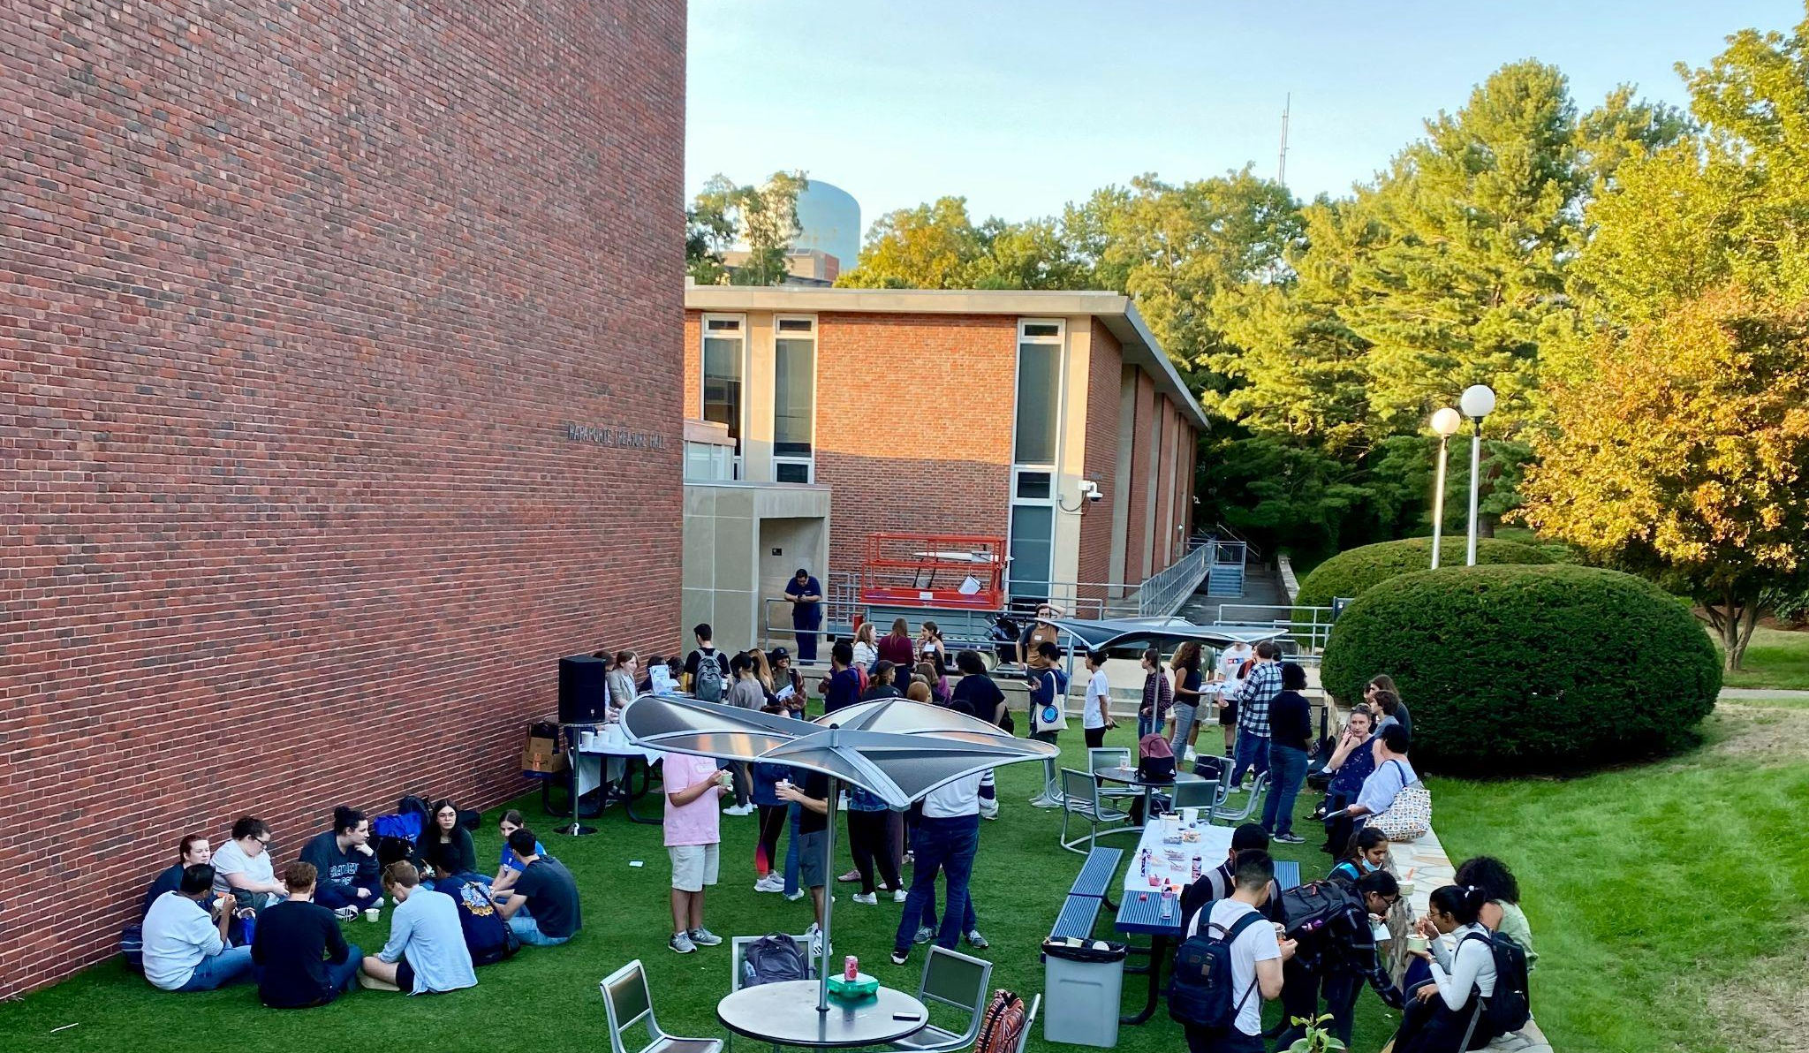
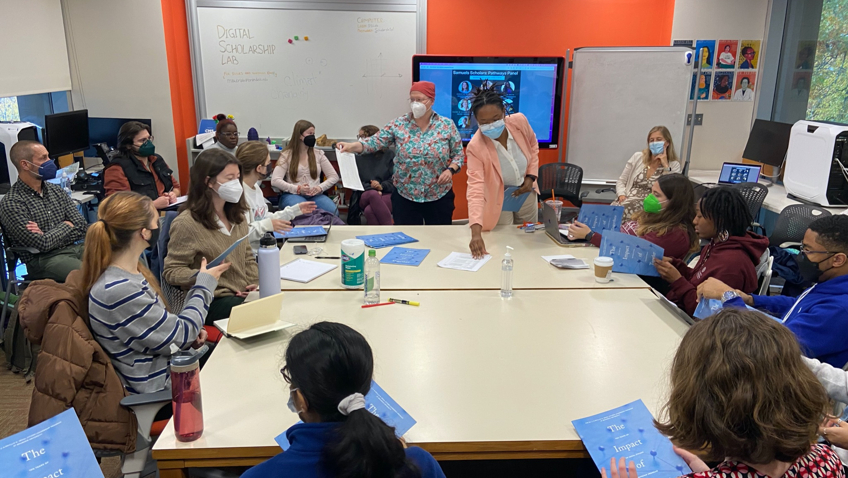
Programs for Students
Community Engaged Scholars Program
Samuels Scholars Program
Common Good Careers Cohort
FCAS Fellowship Program
Global Community Engagement
ENACT

Slide 5
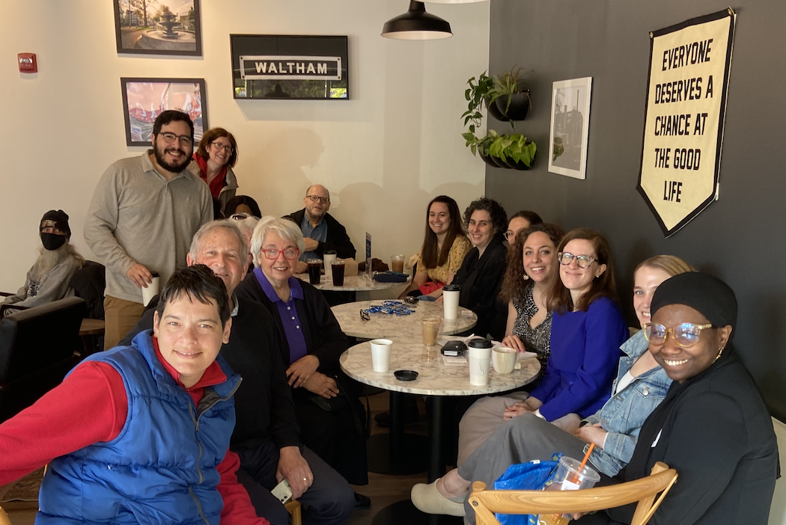
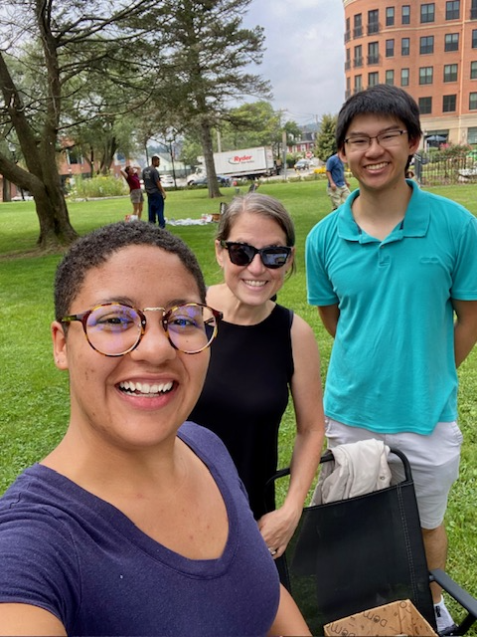
Providing a “Front door” to the university for community partners
“Matchmaking” between community and campus partners
Community Partnership Interest Form
Community Partner News and Events (Campus Groups)
Providing MOU and SOP documents
Participating in community events
COMPACT’s Coffee Connect Series (3rd Friday of every month)

Slide 6
What is community engagement?
With a partner:
What’s YOUR definition of community engagement?
How would you describe your experiences with community engagement to date?
Looking forward, what are your hopes/plans for community engaged teaching and/or research?
Together:
Report back and identify (any?) themes

Slide 7
Carnegie Foundation definition
Community engagement describes collaboration between institutions of higher education and their larger communities (local, regional/state, national, global) for the mutually beneficial exchange of knowledge and resources in a context of partnership and reciprocity.
The purpose of community engagement is the partnership of college and university knowledge and resources with those of the public and private sectors to enrich scholarship, research, and creative activity; enhance curriculum, teaching, and learning; prepare educated, engaged citizens; strengthen democratic values and civic responsibility; address critical societal issues; and contribute to the public good.

Slide 8
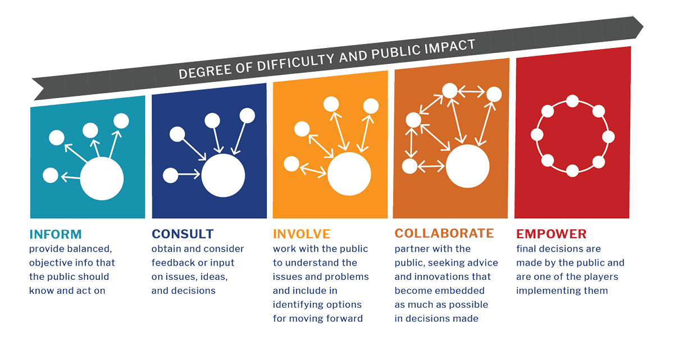
a Continuum of engagement
Image credit: Harvard Catalyst

Slide 9
Community Engaged Pedagogy fund
Project Grants
This grant offers up to $2,500 in funds for community engaged research or creative projects that will be conducted in a Brandeis course. Applications for Spring 2024 classes are due Dec. 1, 2023.
Mini-Grants
This program offers up to $500 in funding to bring community partners to campus as guest speakers in a class (e.g., honoraria), to bring students off campus for a specific community engaged project or event or to conduct small-scale community engaged research or creative projects in a Brandeis course. Grant applications for AY23-24 are being accepted on a rolling basis, for as long as funds remain available.
https://www.brandeis.edu/compact/grants/engaged-pedagogy.html

Slide 10
exemplars
Rachel Raczka, Journalism Program
Jour 89a, Contemporary Media Internships and Analysis
Community Partner: Waltham Partnership for Youth
Project: Smells Like Zine Spirit: A student-produced community resource for new Waltham families
Emilie Diouf, English Department
ENG 52a, Refugee Stories, Refugee Lives
Community Partner: Africano Waltham
Project: Tying the Kaleesu: Archiving Cultural Heritage with Africano Waltham

Slide 11
Community engaged research fund
Project Grant
This grant offers up to $2,500 in seed funding for community engaged research projects. This grant is available to faculty, staff and postdoctoral fellows. The next deadline for review is March 1, 2024.
Mini-grants
The Community Engaged Research Mini Grant offers up to $500 to support development and/or implementation of a small-scale community engaged research project. This grant is available to faculty, staff, postdoctoral fellows, and both undergraduate and graduate students. Students' applications must include a letter of support from a faculty advisor who will provide mentorship for their project. Grant applications for AY23-24 are being accepted on a rolling basis, for as long as funds remain available.
https://www.brandeis.edu/compact/grants/engaged-research.html

Slide 12
exemplars
Rachel Kramer Theodorou, Education Program
"Celebration, Evaluation & Next Steps for Waltham Speaks"
Community Partner: Waltham Family School
Wendy Cadge and Muna Guvenc Ospina Leon, Departments of Sociology and Fine Arts
“Racial Disparities in the Wealth and Property Values of Boston’s Historic Churches”
Community Partner: Mass Council of Churches
Gowthaman Ranganathan, Anthropology
"Archiving Queerness in Jaffna"
Community Partner: Jaffna Transgender Network (JTN)

Slide 13
What is the review committee looking for?
Does the proposed project advance the goals/priorities of the community partner?
Is the proposed project based in a well established (ethical, reciprocal, sustainable) partnership?
Will the proposed project engage Brandeis students?
Especially for research projects:
Will the grant be used as seed funding to develop a sustainable long term partnership?
Is there a clear plan for assessing project outcomes (and/or well defined deliverables)?

Slide 14
Where do I even begin?
Resources for Community Engagement: https://www.brandeis.edu/compact/resources/index.html
Research: https://www.brandeis.edu/compact/resources/cer-resources.html
Pedagogy: https://www.brandeis.edu/compact/resources/cep-resources.html
Come talk with us!
Sara – sshostak@brandeis.edu
Megan – meganross@brandeis.edu
COMPACT – compact@brandeis.edu

Slide 15
Q&A
& thank you!!!
Notes:
SARA

